Slide 1
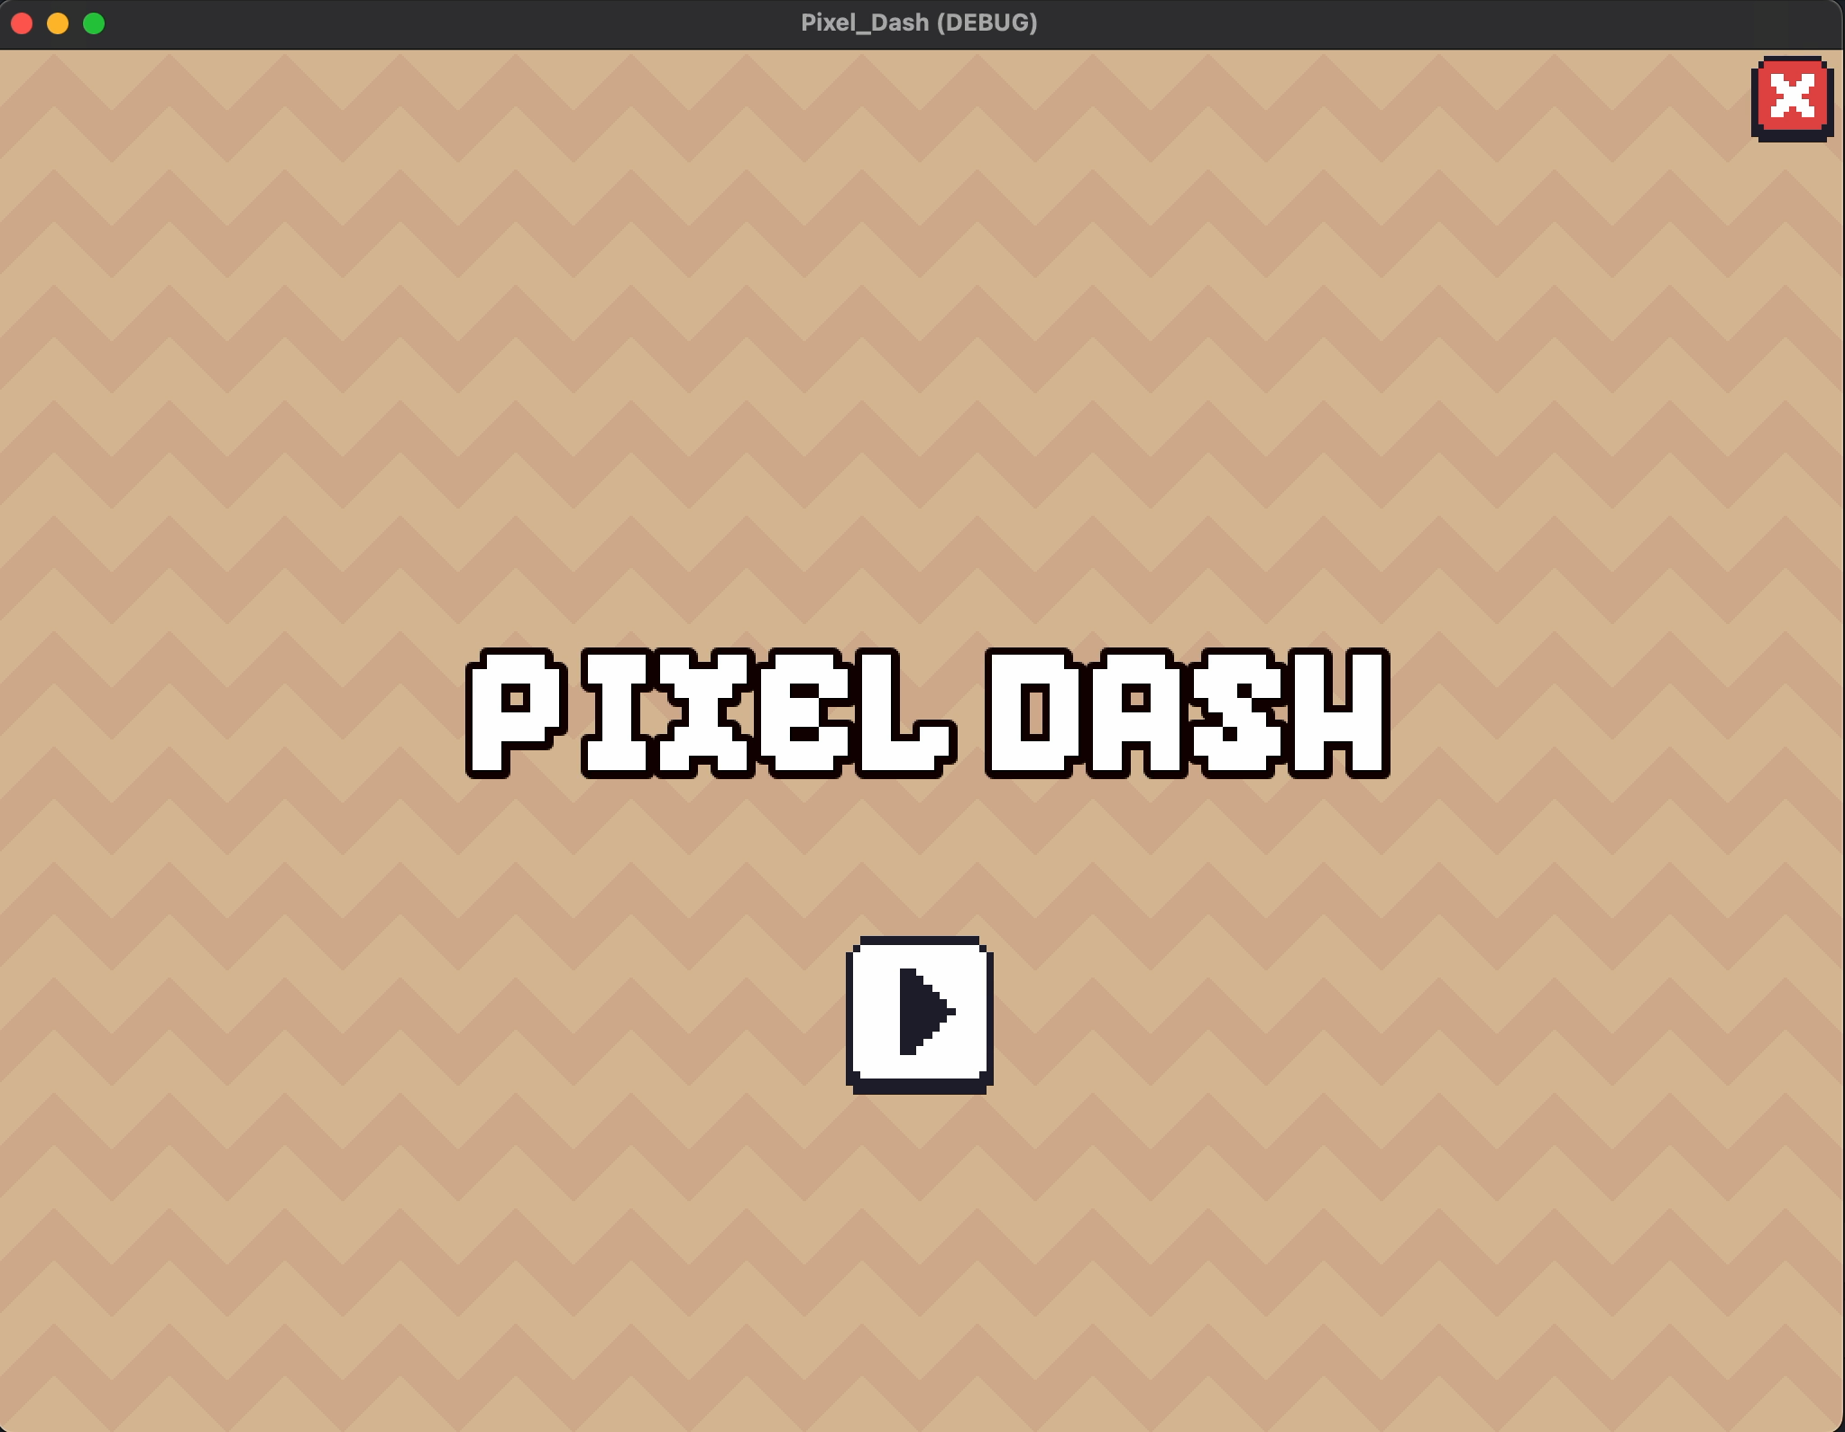
Build Your First 2D Game with Godot
Brandon Lewis
Download Art Assets and Slides at:
https://github.com/brandon-lewis/CodeMash2023-PixelDash
Download the Standard version of Godot 3.5 (not Mono)

Slide 2
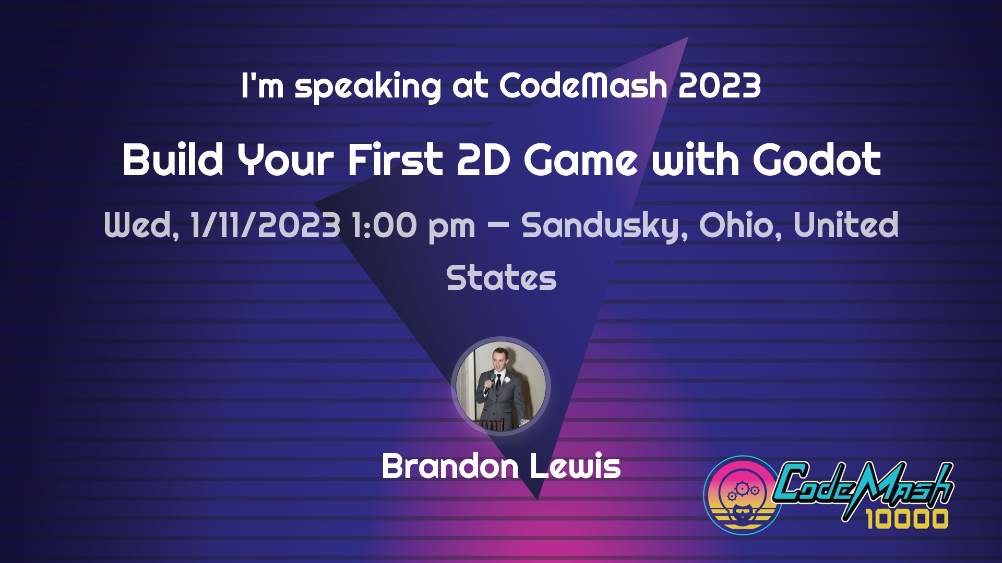


About Me
Session Resources: https://github.com/brandon-lewis/CodeMash2023-PixelDash
Consultant, hobbyist, gamer, general geek
“IoT from Sensing to Insights Workshop” - CodeMash 2021
brandonmlewis
brandon-lewis

Slide 3
What is Godot Engine?
Session Resources: https://github.com/brandon-lewis/CodeMash2023-PixelDash
A completely free and open-source (MIT license) general-purpose 2D and 3D game engine.
Build games or applications for desktop (Linux, MacOS, Windows), mobile (Android, iOS), and game consoles.
Offers multiple languages for development – GDScript, C#, and GDNative which supports C++ and C.

Slide 4
What is Godot Engine?
Session Resources: https://github.com/brandon-lewis/CodeMash2023-PixelDash
BENEFITS
DRAWBACKS
Uses widely-supported OpenGL renderer.
GDScript is a high-level, dynamically-typed language.
Version-control friendly.
Completely free and open source.
Editor plugins are first-class citizens.
No Vulkan or Direct3D support until Godot 4.
GDScript is a high-level, dynamically-typed language.
Not as mature as the more popular engines.
Primarily used by solo and small-team indie developers.

Slide 5
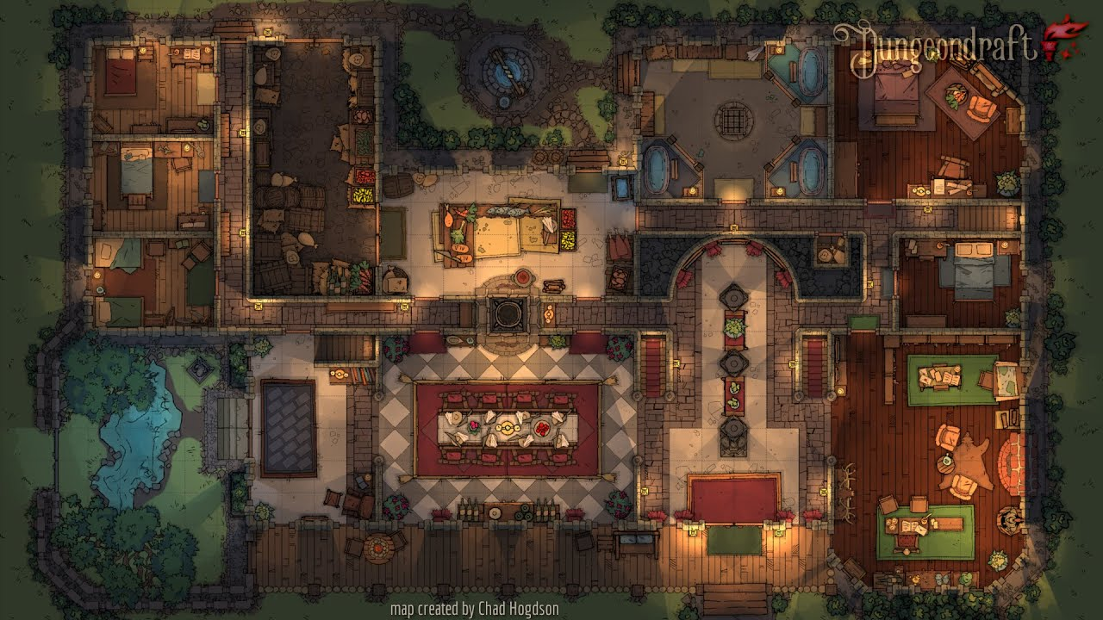
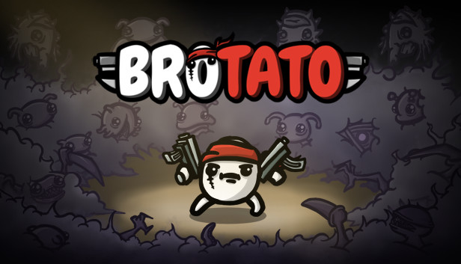

Notable games/apps made with Godot
Session Resources: https://github.com/brandon-lewis/CodeMash2023-PixelDash
Dungeondraft
Brotato (20.2k Steam reviews, 97% positive)
Dome Keeper (4.8k Steam reviews, 90% positive)

Slide 6
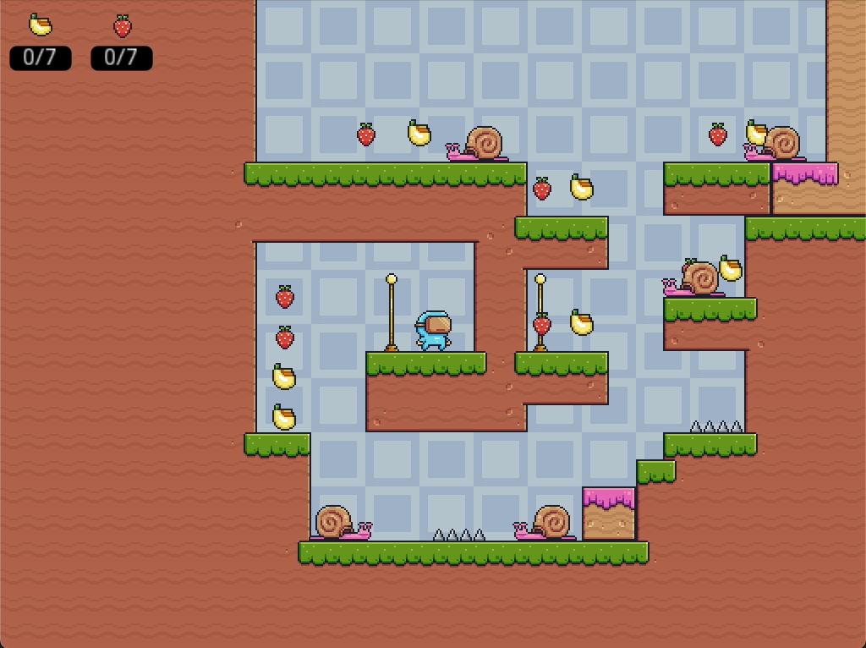
Session Goals
Session Resources: https://github.com/brandon-lewis/CodeMash2023-PixelDash
Controllable Player
Reusable Base Level
Player & Level Polish (Camera, Gravity, Sound, Background)
Level Checkpoints
Hazards & Player Respawn
Collectibles & HUD
A Basic Enemy
Main Menu & Changing Scenes
Open Workshop, Tinker Time

Slide 7
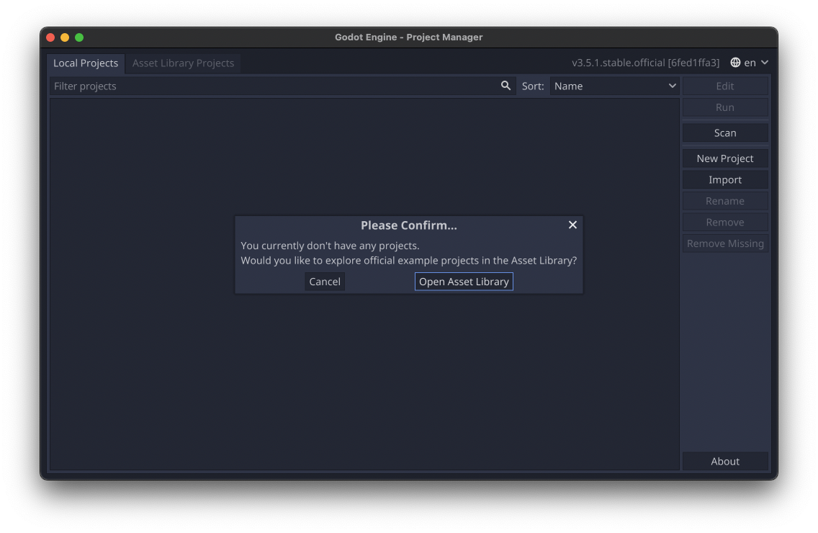
Session Resources: https://github.com/brandon-lewis/CodeMash2023-PixelDash

Slide 8
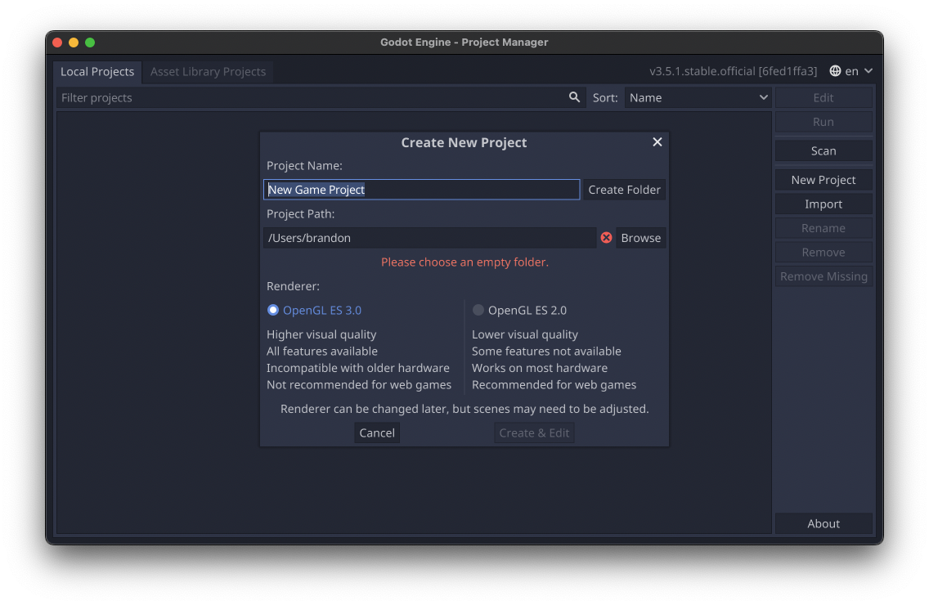
Create a New Project
Session Resources: https://github.com/brandon-lewis/CodeMash2023-PixelDash

Slide 9
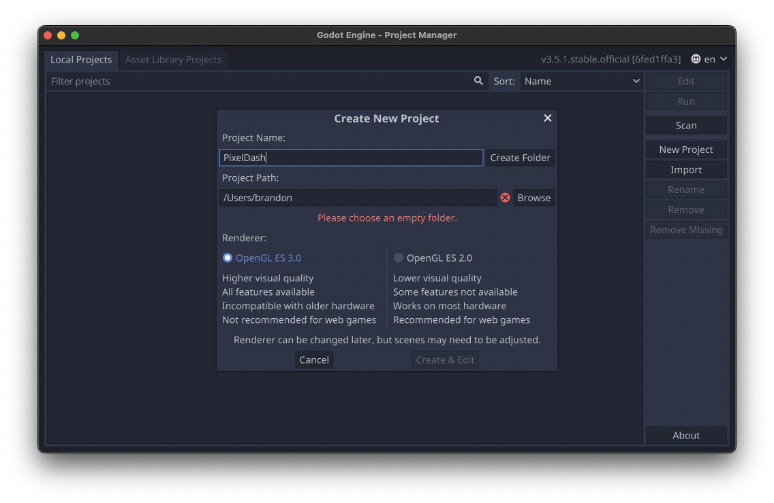
Create a New Project
Session Resources: https://github.com/brandon-lewis/CodeMash2023-PixelDash
OpenGL ES 3.0
Offers better shader features and performance.
Risky compatibility for games on mobile devices.
OpenGL ES 2.0
No GPU particles (can use CPUParticles instead).
Incapable of HDR rendering.
Lack of post-processing features.

Slide 10
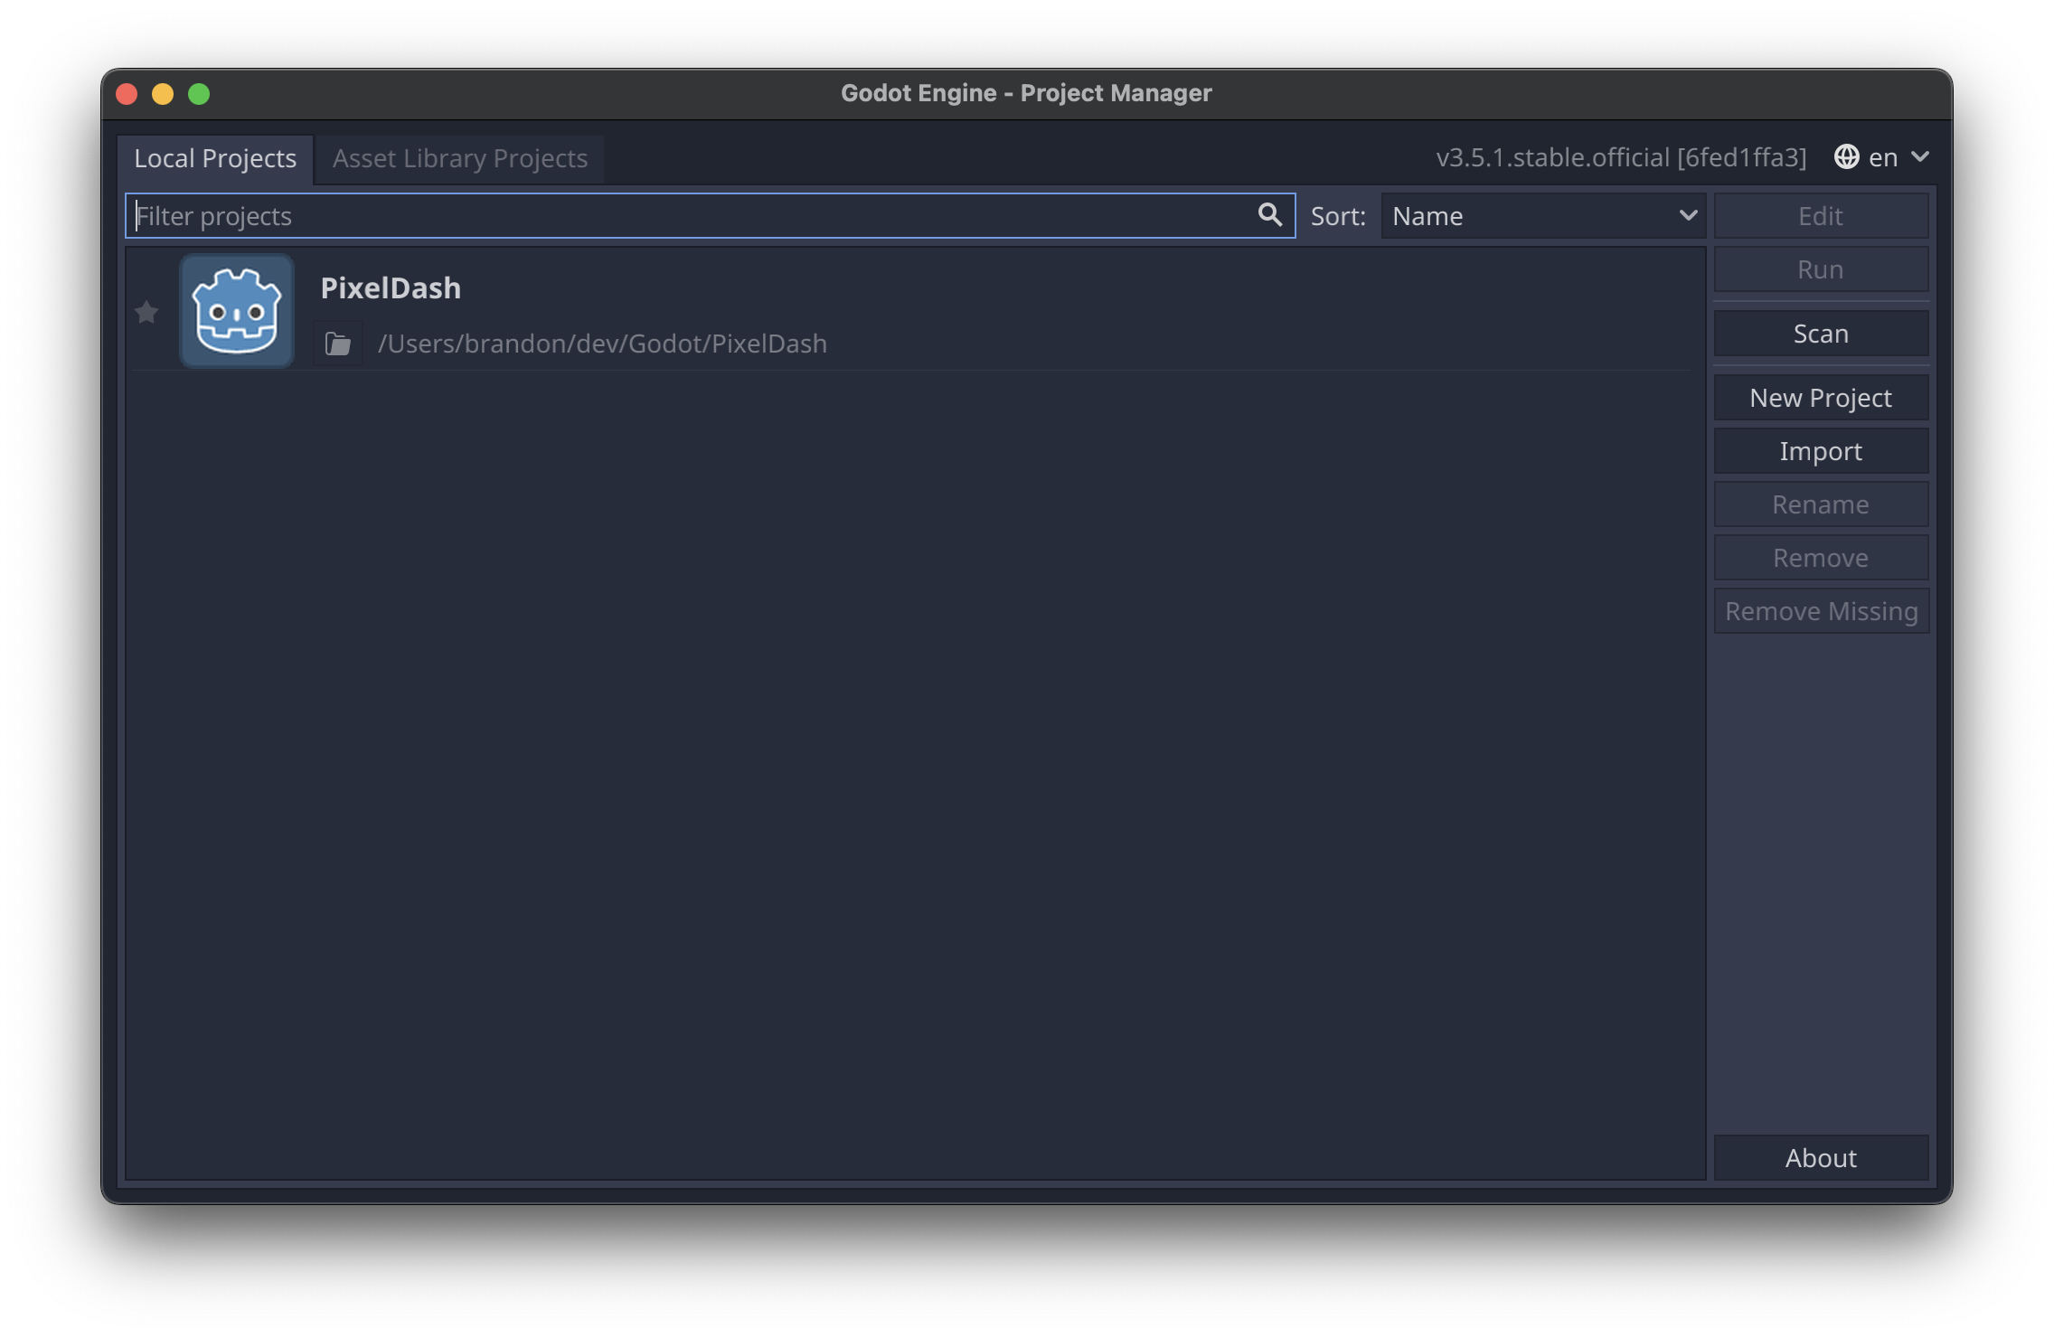
Exploring the Editor
Session Resources: https://github.com/brandon-lewis/CodeMash2023-PixelDash

Slide 11
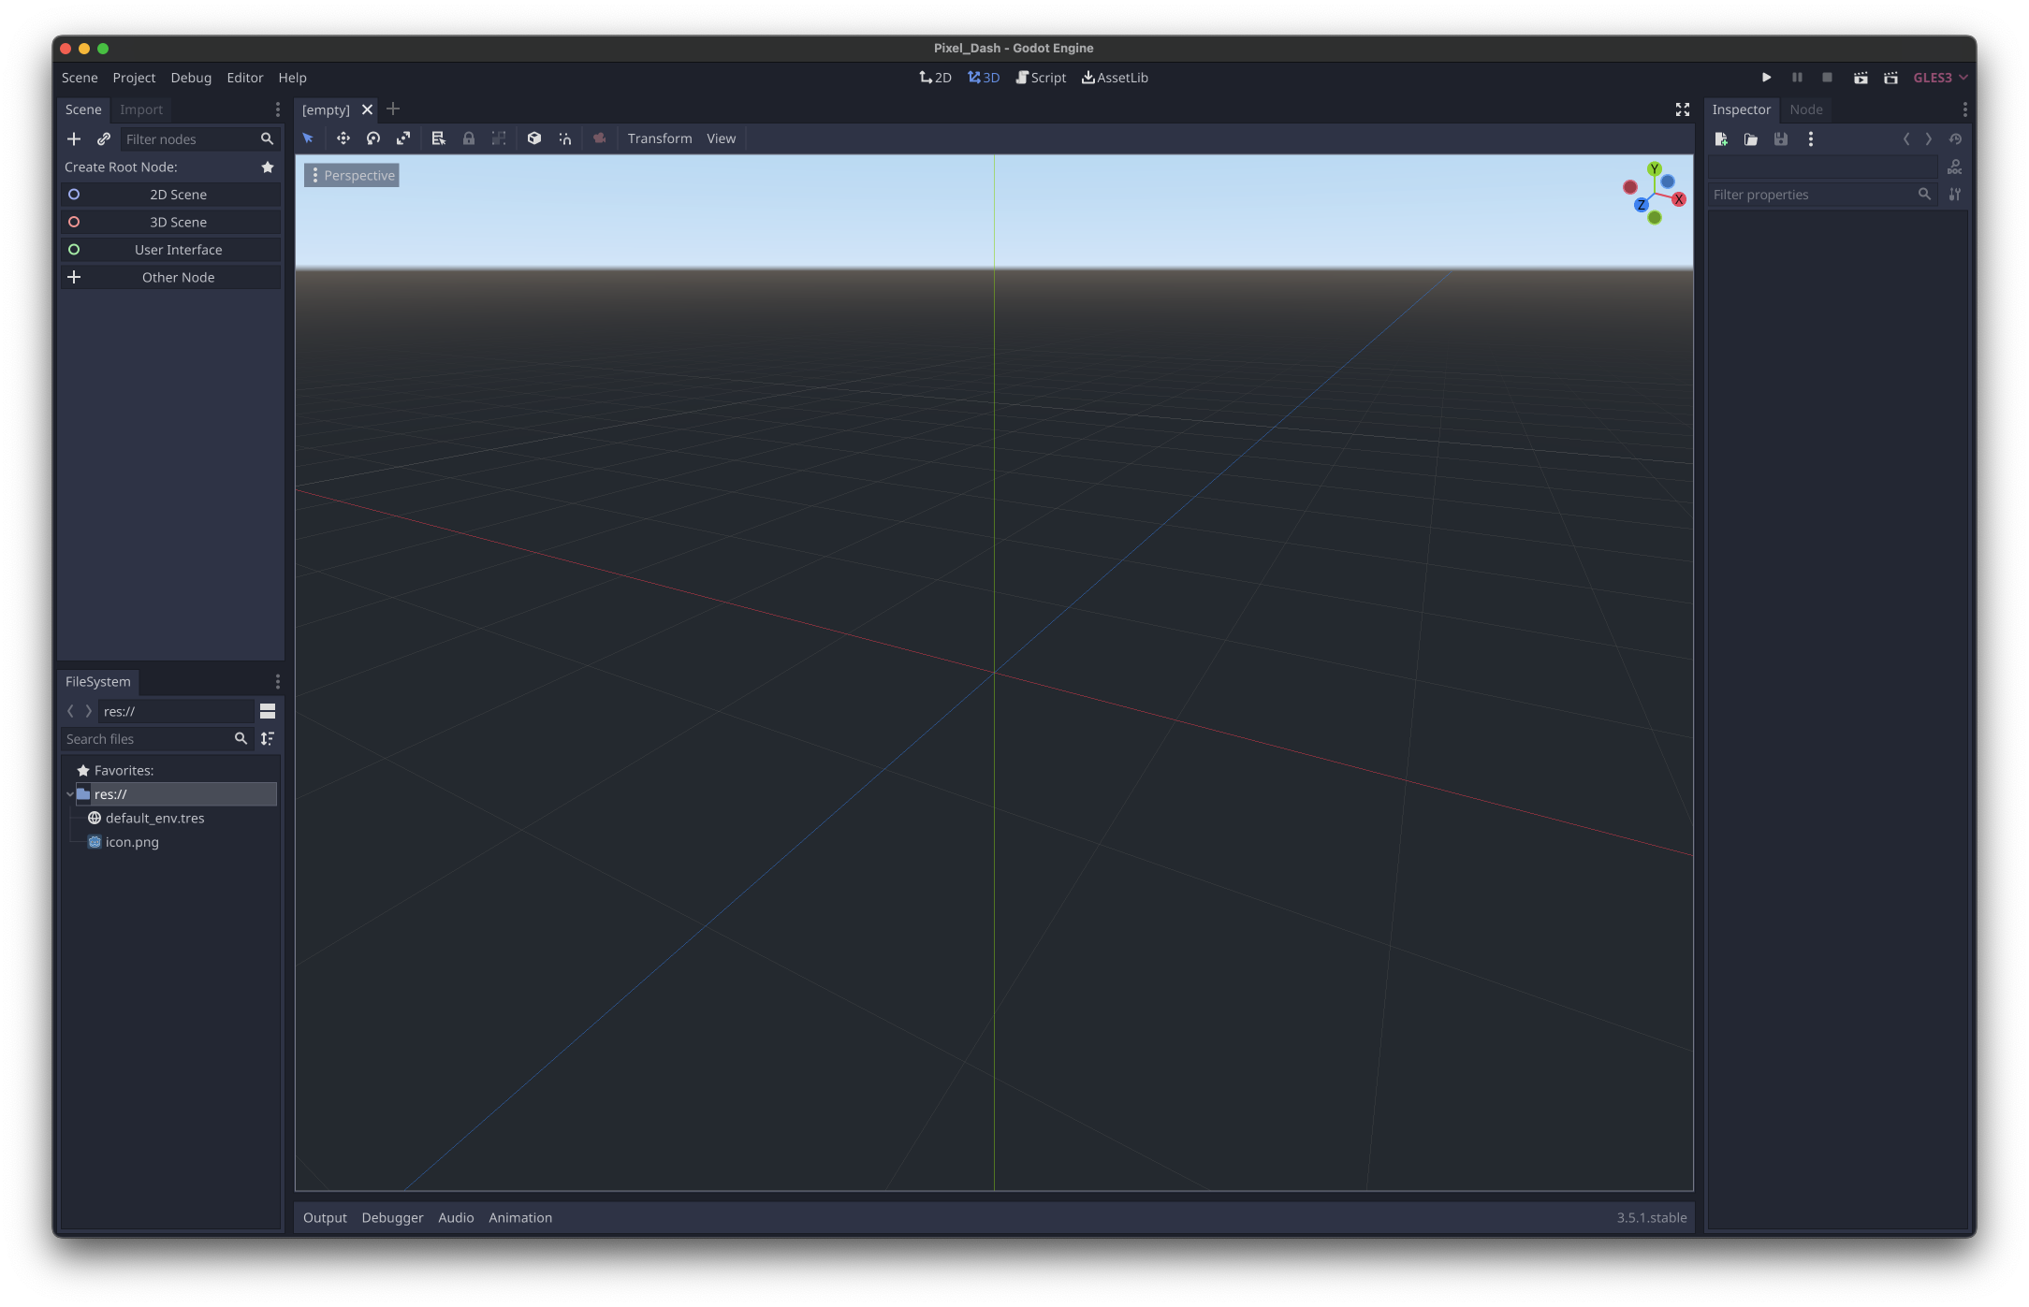
Session Resources: https://github.com/brandon-lewis/CodeMash2023-PixelDash

Slide 12
Session Resources: https://github.com/brandon-lewis/CodeMash2023-PixelDash
Scene Tree

Slide 13
Session Resources: https://github.com/brandon-lewis/CodeMash2023-PixelDash
Project File System Tree

Slide 14
Session Resources: https://github.com/brandon-lewis/CodeMash2023-PixelDash
Scene View

Slide 15
Session Resources: https://github.com/brandon-lewis/CodeMash2023-PixelDash
Scene View

Slide 16
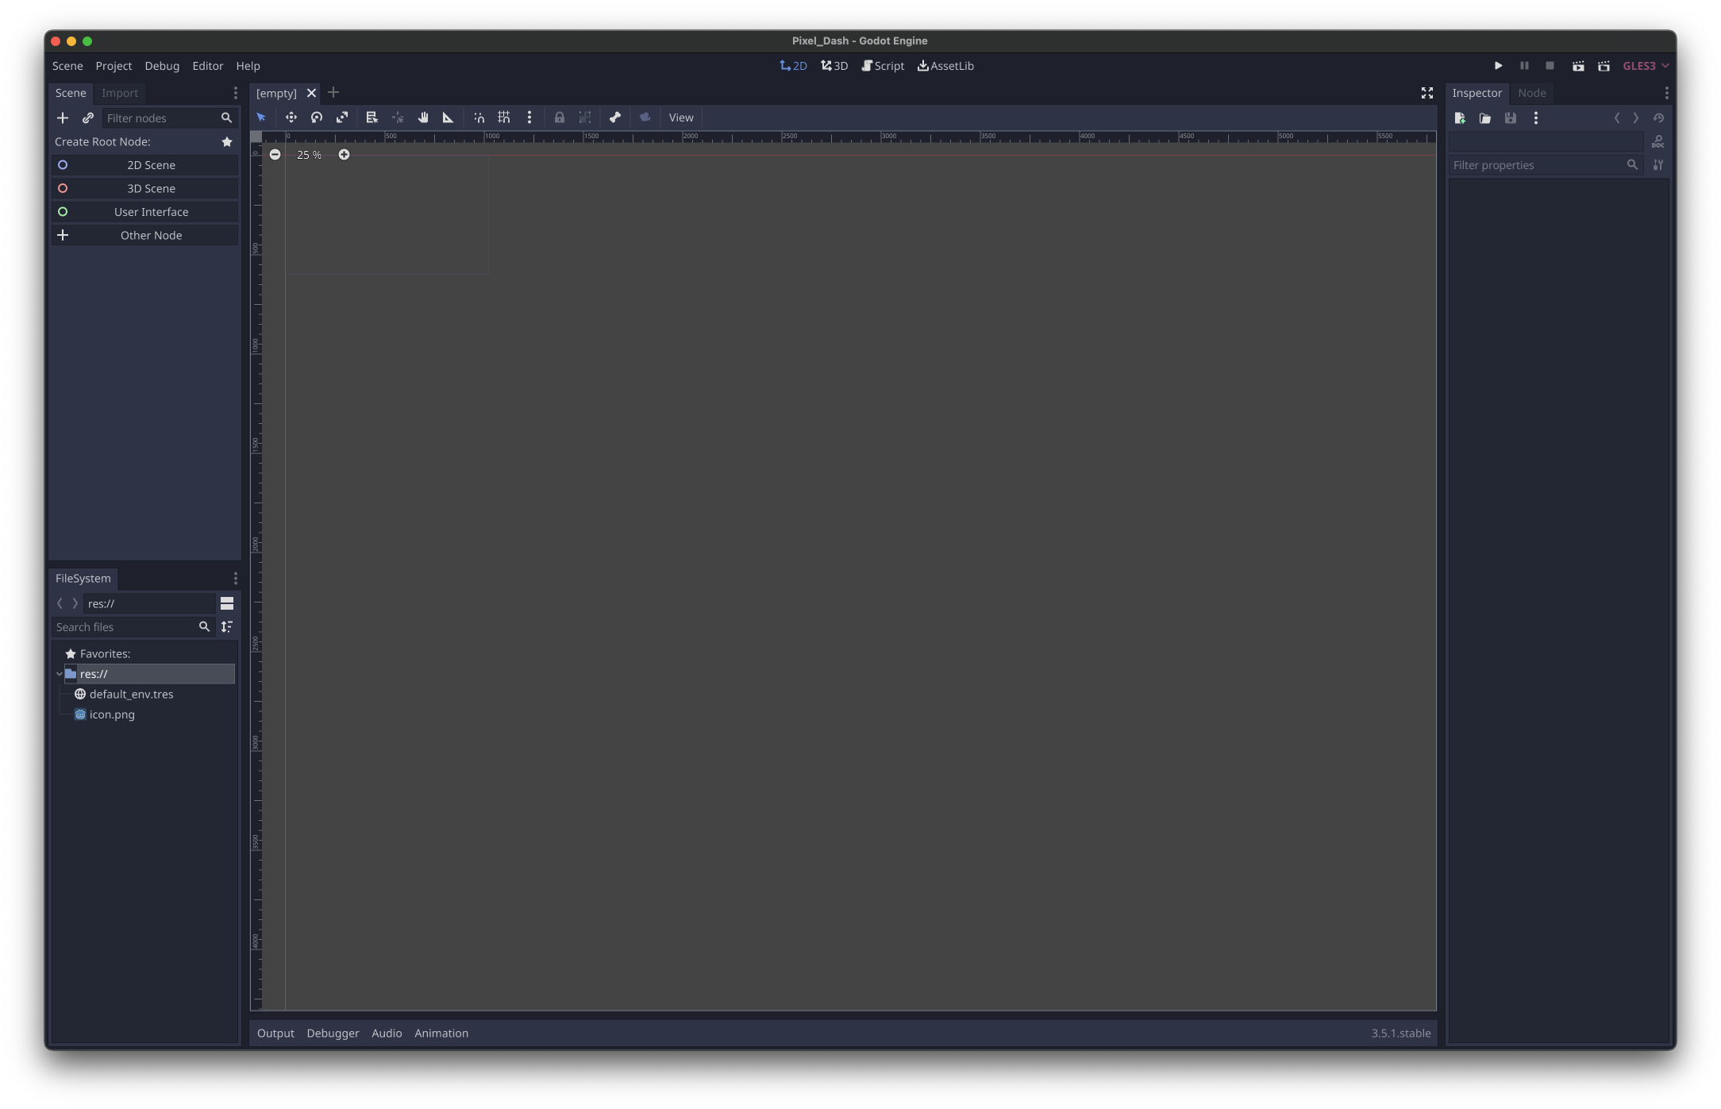
Session Resources: https://github.com/brandon-lewis/CodeMash2023-PixelDash
Switch to the 2D View

Slide 17
Session Resources: https://github.com/brandon-lewis/CodeMash2023-PixelDash
Scene Control Tools

Slide 18
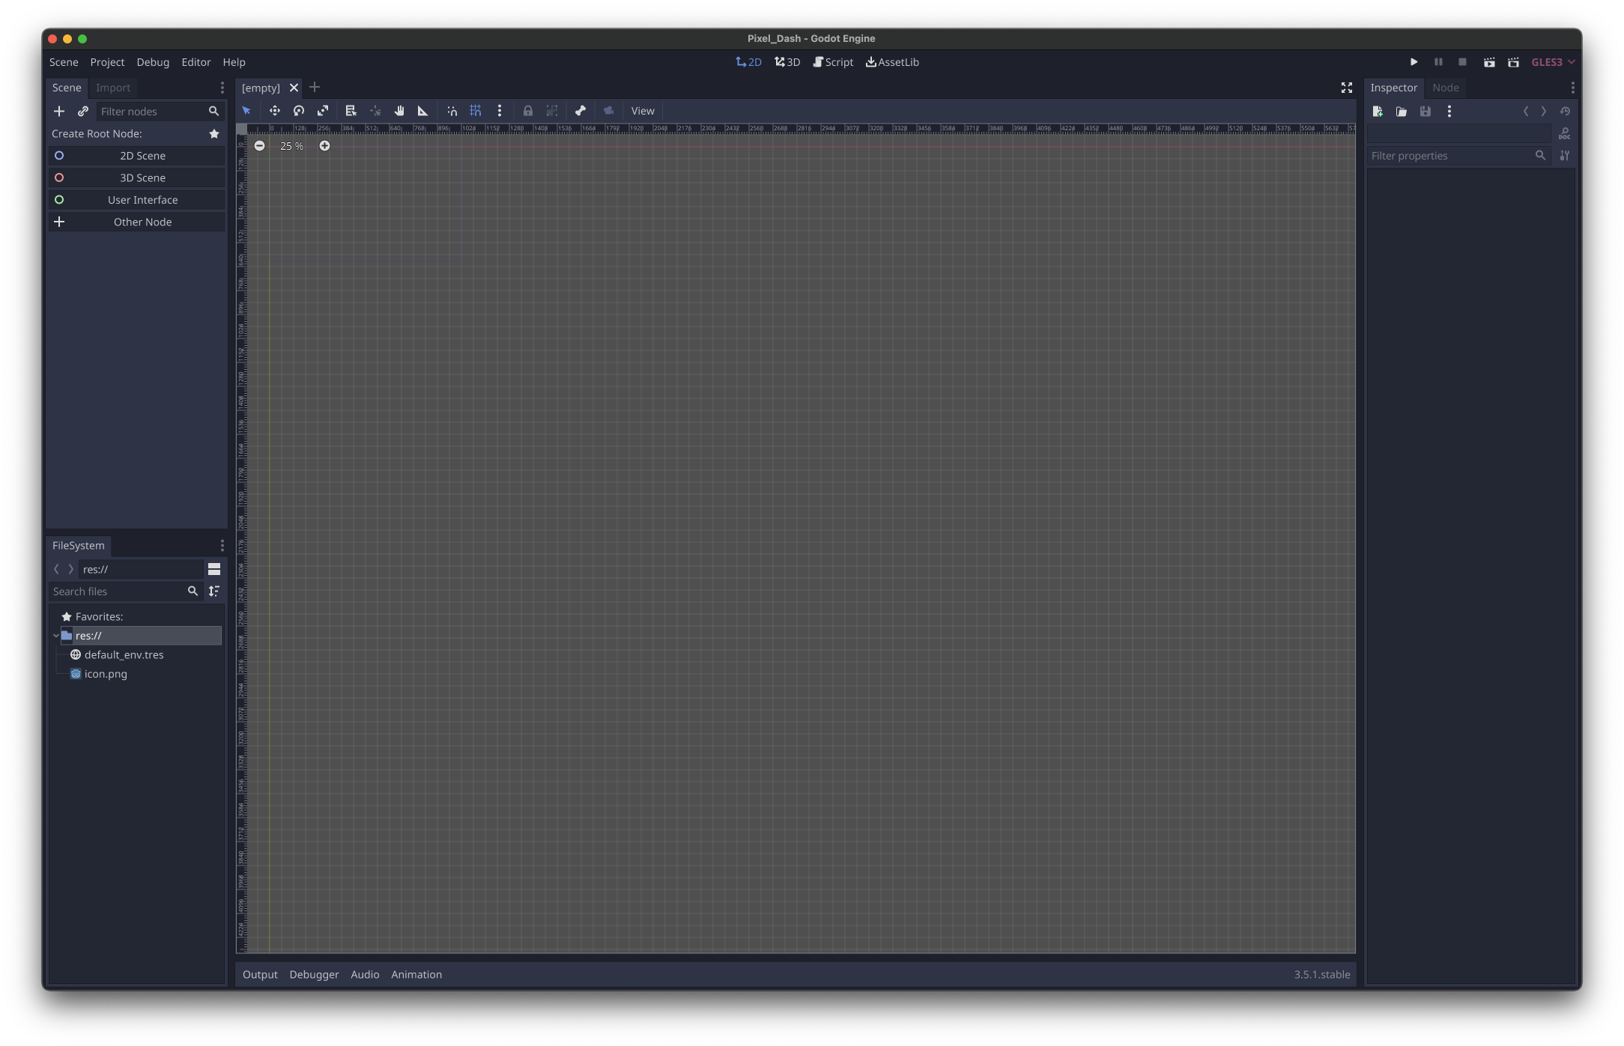
Session Resources: https://github.com/brandon-lewis/CodeMash2023-PixelDash
Toggle Grid Snap

Slide 19
Session Resources: https://github.com/brandon-lewis/CodeMash2023-PixelDash
Scene Zoom

Slide 20
Session Resources: https://github.com/brandon-lewis/CodeMash2023-PixelDash
Click this Output button/tab

Slide 21
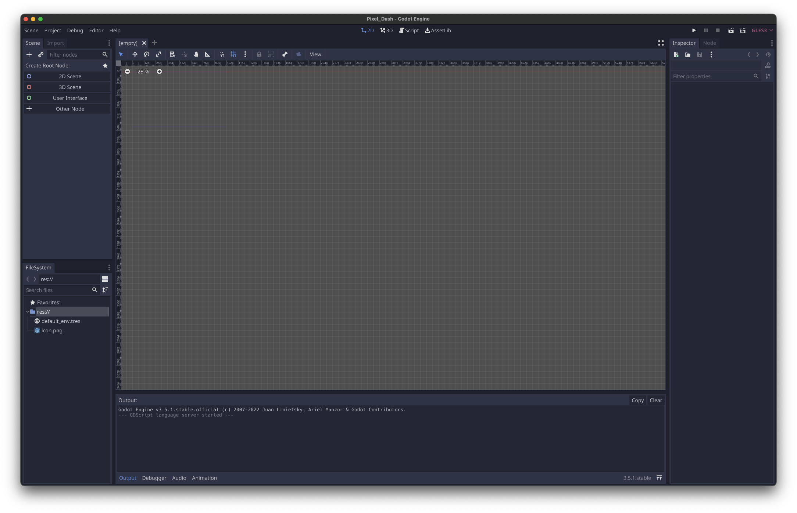
Session Resources: https://github.com/brandon-lewis/CodeMash2023-PixelDash
Console

Slide 22
Session Resources: https://github.com/brandon-lewis/CodeMash2023-PixelDash
Run Controls

Slide 23
Session Resources: https://github.com/brandon-lewis/CodeMash2023-PixelDash
Inspector Tab

Slide 24
Session Resources: https://github.com/brandon-lewis/CodeMash2023-PixelDash
Node Tab

Slide 25
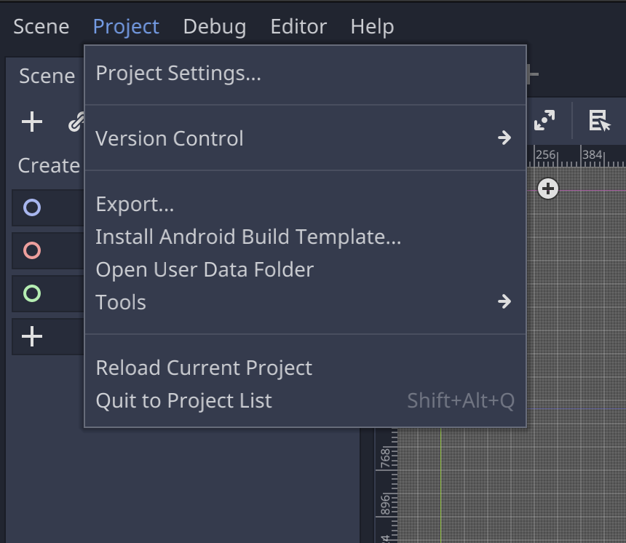
Updating Basic Project Settings
Session Resources: https://github.com/brandon-lewis/CodeMash2023-PixelDash

Slide 26
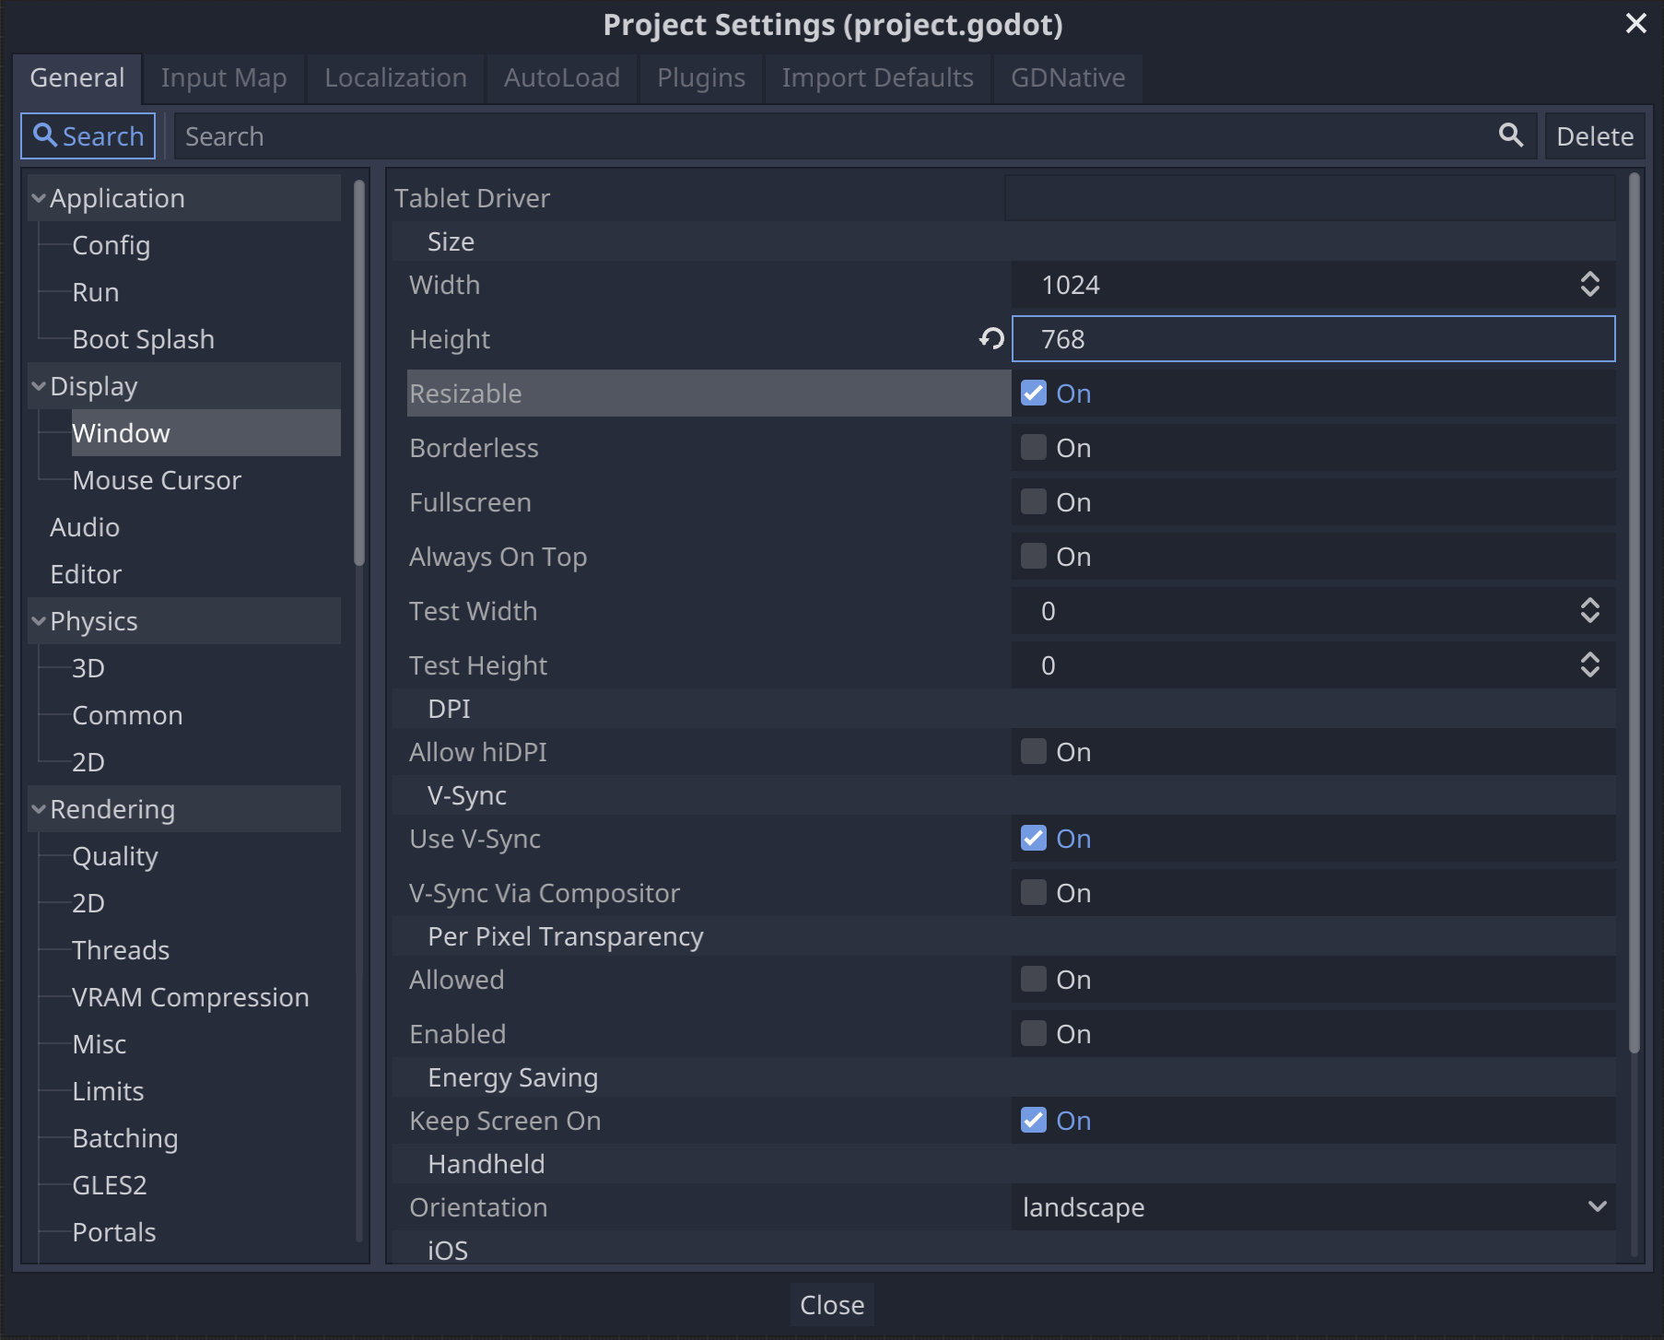
Set Game Window Size to 1024x768
Session Resources: https://github.com/brandon-lewis/CodeMash2023-PixelDash

Slide 27
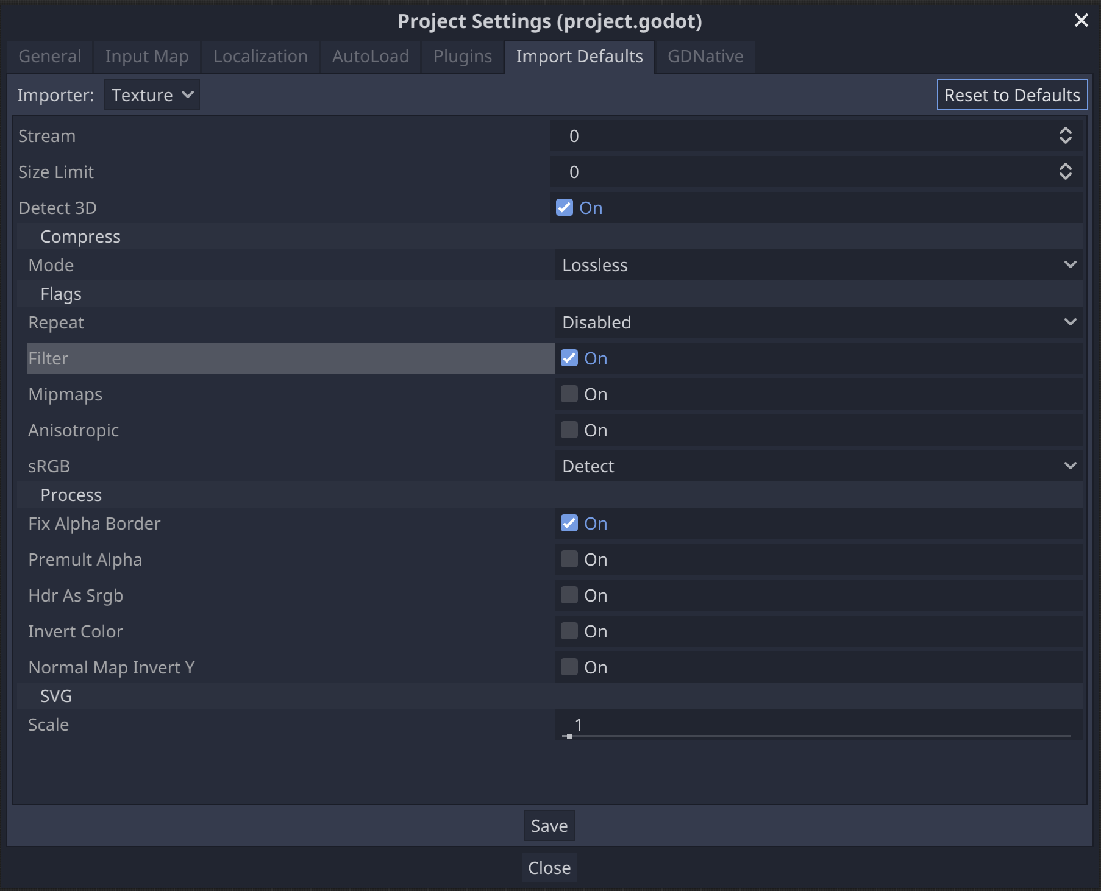
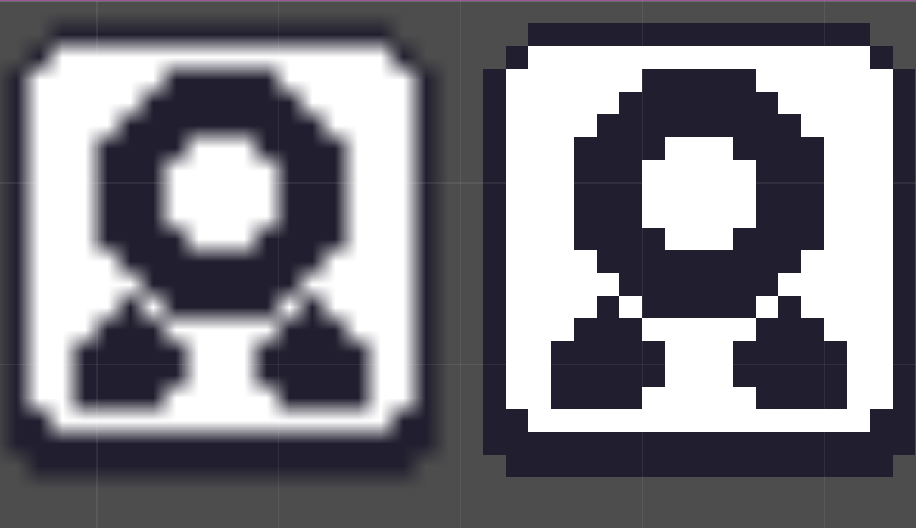
Turn Texture Filtering “Off”
Session Resources: https://github.com/brandon-lewis/CodeMash2023-PixelDash
Filtering
ON
Filtering
OFF

Slide 28
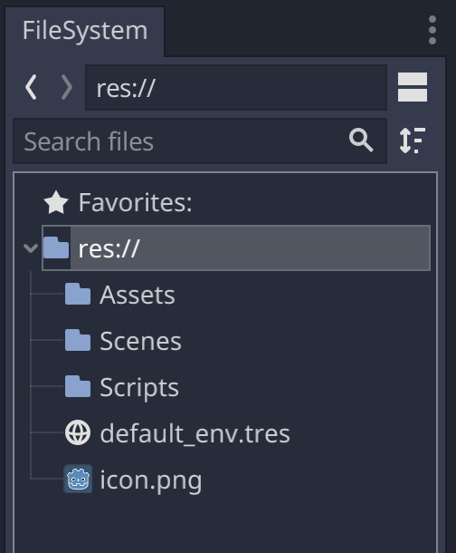
Project Folder Structure
Session Resources: https://github.com/brandon-lewis/CodeMash2023-PixelDash
res:// is a relative “Resource” path representing the root file system path of your project.
All project files exist in res://
Create the following folders:
Assets
Scenes
Scripts

Slide 29
Importing Files & Assets
Session Resources: https://github.com/brandon-lewis/CodeMash2023-PixelDash
To import, you can simply drag-and-drop files into the FileSystem tab from your OS file explorer.
Note: Files imported via drag-and-drop into the FileSystem tab will import the files into the currently selected folder.
WARNING: If you end up moving project files around, it’s best to move those files using the FileSystem tab.

Slide 30
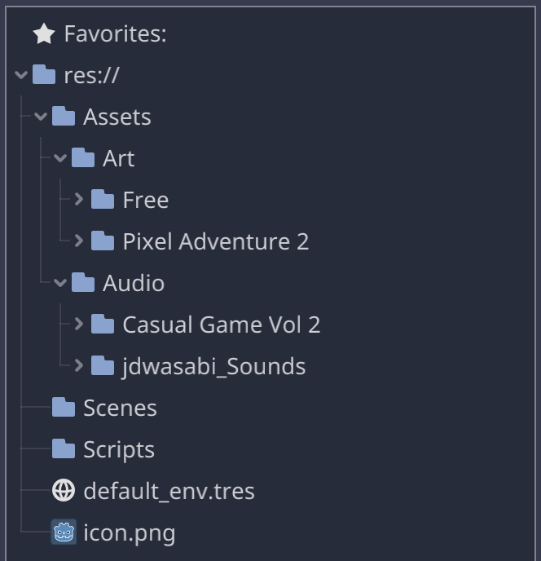
Import the Art & Audio Assets
Session Resources: https://github.com/brandon-lewis/CodeMash2023-PixelDash
Import the assets downloaded from the GitHub page into the project.
Your project structure does not have to match perfectly, as we will not be accessing these assets via resource paths.
Note: Godot will create a .import file for every imported file to keep track of that file’s settings.

Slide 31

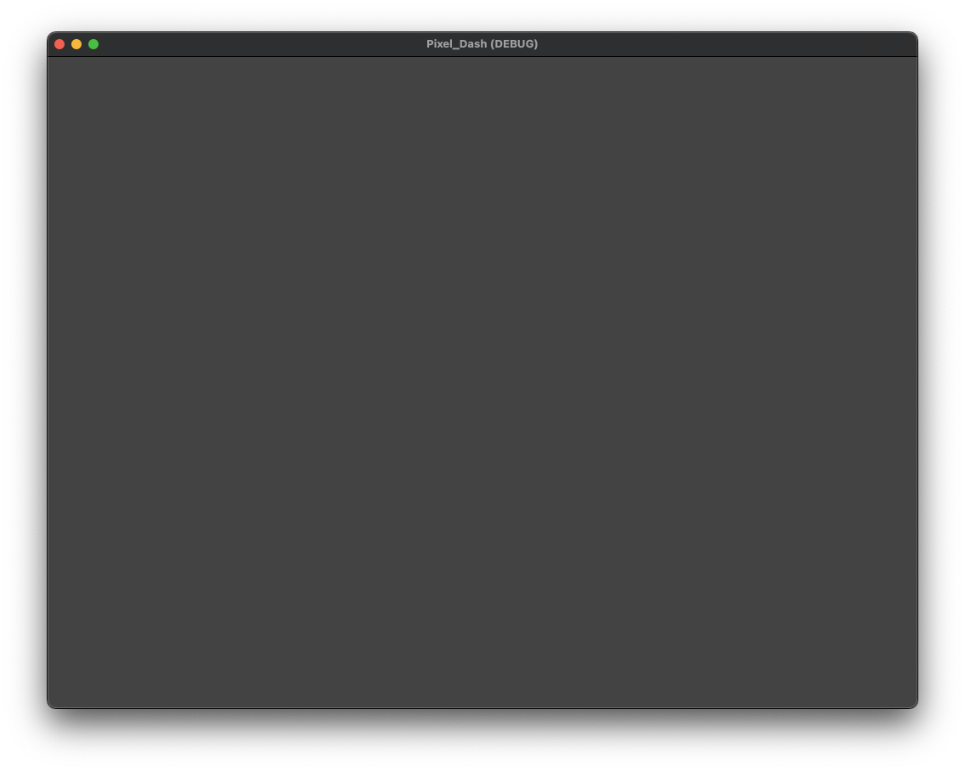
Lab Time (~5 Minutes)
https://github.com/brandon-lewis/CodeMash2023-PixelDash
Download workshop dependencies.
Create the new project.
Update the project settings.
Create base folders and import assets.
Click around and get a feel for the editor.

Slide 32

Session Goal #1: Controllable Player
Controllable Player
Reusable Base Level
Player & Level Polish (Camera, Gravity, Sound, Background)
Level Checkpoints
Hazards & Player Respawn
Collectibles & HUD
A Basic Enemy
Main Menu & Changing Scenes
Open Workshop, Tinker Time

Slide 33
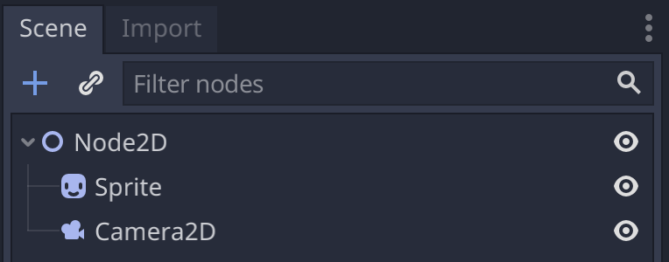
Defining Nodes and Scenes
A Node is a fundamental building block of a scene (akin to a single LEGO brick).
A Scene is a tree of nodes. Every scene has exactly one root node.
When we run the Game, we are always executing at least one top-level Scene.
A scene can be imported as a node in any other scene.

Slide 34
Defining Nodes and Scenes
A Node is a fundamental building block of a scene (akin to a single LEGO brick).
A Scene is a tree of nodes. Every scene has exactly one root node.
When we run the Game, we are always executing at least one top-level Scene.
A scene can be imported as a node in any other scene.

Slide 36
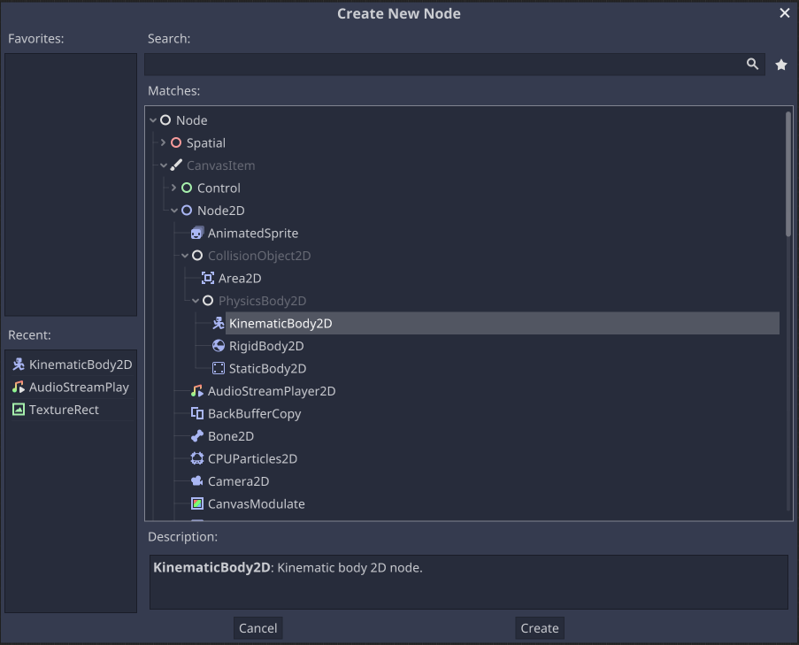

Slide 41
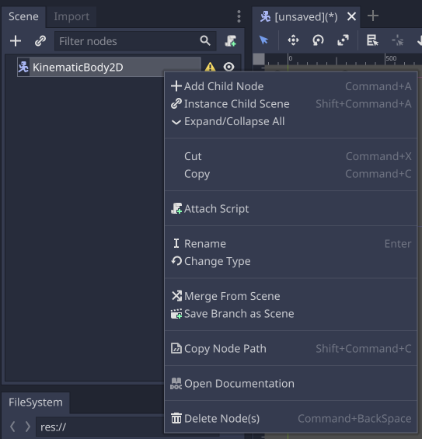
Adding Child Nodes to a Scene
To add child node:
Click this “Add Child Node” button above the Scene Tree.
Right-click the root node and add select “Add Child Node”.
Note: There is only one root node per scene. Any node (besides the root) can be nested as a child of any other node.
1

Slide 42
Adding Child Nodes to a Scene
To add child node:
Click this “Add Child Node” button above the Scene Tree.
Right-click the root node and add select “Add Child Node”.
Note: There is only one root node per scene. Any node (besides the root) can be nested as a child of any other node.
2

Slide 43
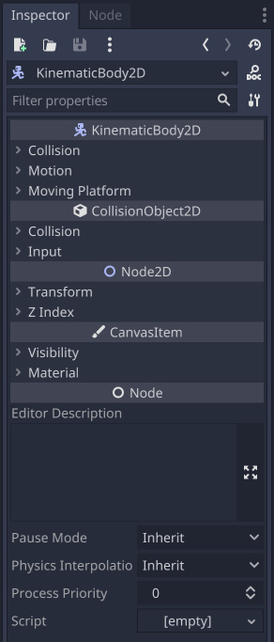
Understanding the Inspector Tab
The Inspector Tab updates whenever you select a node in the Scene Tree or in the central Scene Editor.
Each node has its own properties based on the type of the node and that node’s class inheritance hierarchy.

Slide 44
Understanding the Inspector Tab
The Inspector Tab updates whenever you select a node in the Scene Tree or in the central Scene Editor.
Each node has its own properties based on the type of the node and that node’s class inheritance hierarchy.

Slide 45
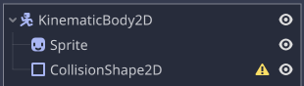
Creating the Player Scene
In the current Scene, create the root node as a KinematicBody2D.
Add a Sprite node as a child of the KinematicBody2D.
Add a CollisionShape2D node as a child of the KinematicBody2D.

Slide 46
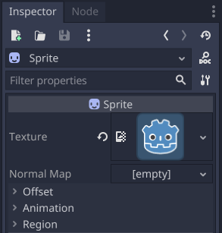
Creating the Player Scene
With the Sprite node selected in your Scene tree:
Find the Texture property with an [empty] value in the Inspector.
Drag the icon.png file in your FileSystem tab into the Texture’s [empty] value.

Slide 47
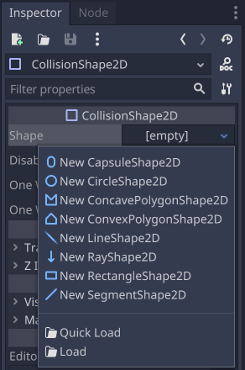
Setting Collision on a CollisionShape2D
Select the CollisionShape2D in your Scene tree:
Click the Shape property dropdown and choose one of the following collision shape options:
Capsule: A good option if you want forgiving corners & some “slippery” edges.
Rectangle: Good for strict edges and larger wall/floor detection.
Stretch the size of your collision shape to be about the same shape as the Sprite.

Slide 48
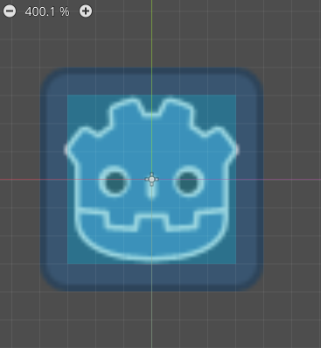
Save the Player Scene!
Create a new Player subfolder in your Scenes folder.
Save the current [unsaved] scene as Player.tscn in the new Player folder.
Note: The .tscn file format stands for “text scene”. This structure is part of what makes Godot so version-control friendly!

Slide 49
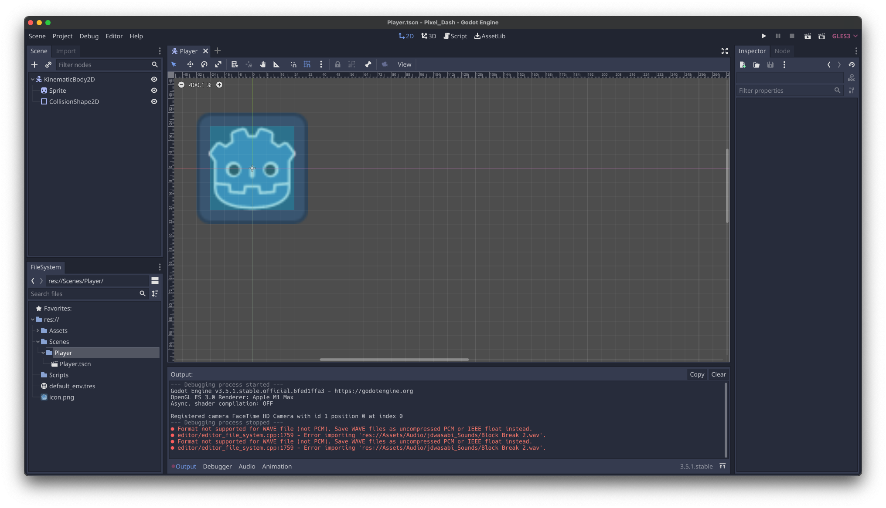
Running the Scene
Run the current scene

Slide 50
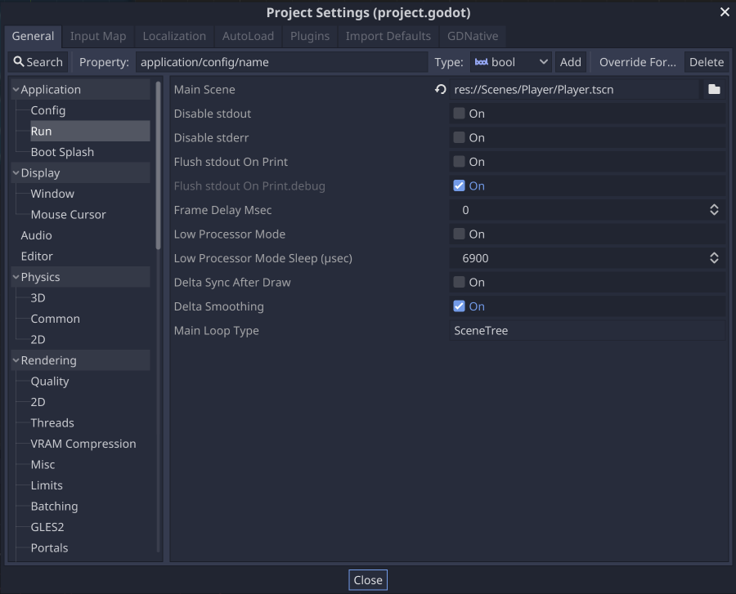
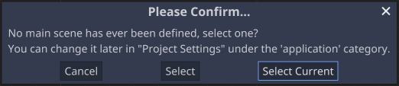
Running the Scene
Run the project’s configured “Main Scene”

Slide 51
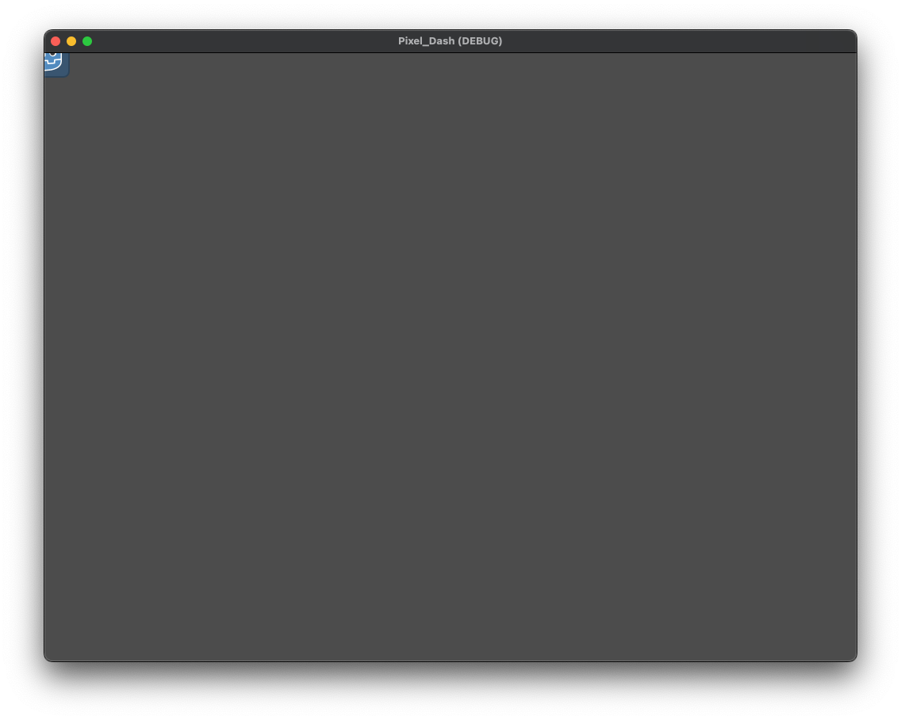
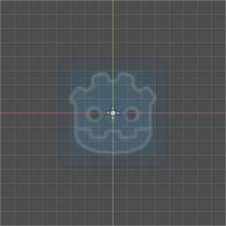
Scene Positions and “Cameras”
When running a scene without a camera, that scene’s default viewport is positioned with the scene’s central position (0,0) in the top left of the window.
Our Sprite & CollisionShape2D nodes are positioned at (0,0).
Given these details, the result is that we end up only seeing the bottom-right corner of our Sprite.
(0,0)

Slide 52
Lab Time (~10 Minutes)
Create a new Player scene.
Assign the Sprite node the logo.png as its texture property.
Give the CollisionShape2D a shape.
Run the Player scene.
Nothing will happen when you run it, but you should see the Sprite in the corner.

Slide 53
Well, this is boring… we need behavior!
Most of the basic nodes that we can add to our scene do not inherently provide behavior based on game state or player interaction.
We can attach a single Script to any node(s) in our scene tree to give it some behavior.
Once a Script is attached to a node, we then add behavior by writing GDScript code in the attached Script.

Slide 54
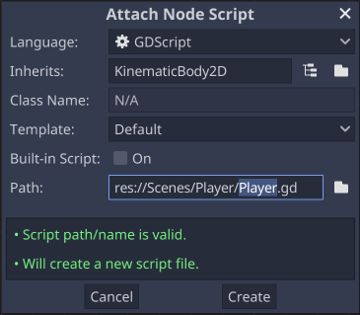
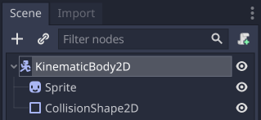
Attaching a Script to the Player
Select the root node (KinematicBody2D) and click the “Attach Script” button.
Accept all the default prompt values and click Create.

Slide 55
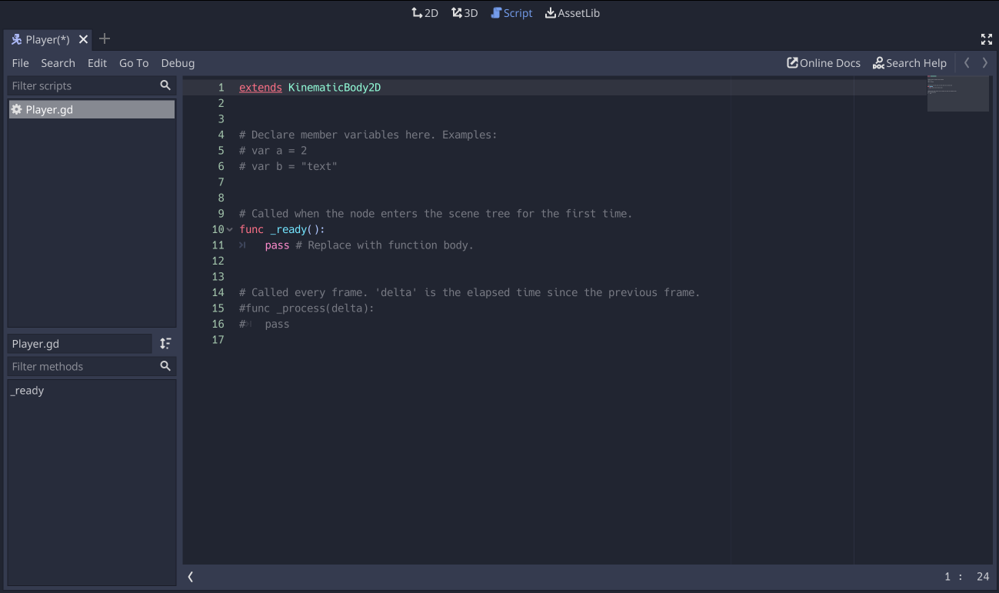

Slide 56
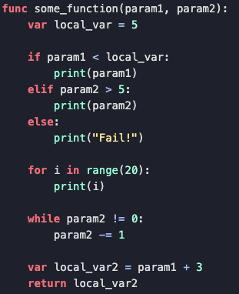
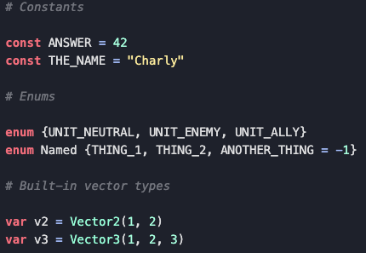
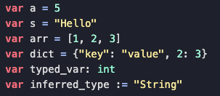
GDScript: A Short Primer
An optimized, high-level, dynamic language.
Highly resembles Python; the syntax is indentation-based and has many similar keywords.

Slide 57
GDScript: Object Notification Methods
Function Name | Use Case(s)
_ready() | Called when the node is added to the active scene tree. This is executed downwards from the root.
_process(delta) | When you need a framerate-dependent delta between frames. Use when you need updates as often as possible. >> Try to avoid doing physics calculations here.
_physics_process(delta) | When you need a framerate-independent delta between frames. Use when you need consistent updates over time. >> Try to avoid doing input processing here.
_input(event) | Called whenever an input event occurs. The input event propagates up through the node tree until a node consumes it.
The delta is the elapsed time since the previous frame was executed/processed.

Slide 58
Player Behavior: Movement & Handling Input
extends KinematicBody2D
var velocity = Vector2.ZERO
onready var move_speed : float = 175 * scale.x
func _physics_process(delta):
var move_left = Input.get_action_strength("ui_left")
var move_right = Input.get_action_strength("ui_right")
velocity.x = (move_right - move_left) * move_speed
var move_up = Input.get_action_strength("ui_up")
var move_down = Input.get_action_strength("ui_down")
velocity.y = (move_down - move_up) * move_speed
velocity = move_and_slide(velocity, Vector2.UP)

Slide 59
Player Behavior: Movement & Handling Input
extends KinematicBody2D
var velocity = Vector2.ZERO
onready var move_speed : float = 175 * scale.x
func _physics_process(delta):
var move_left = Input.get_action_strength("ui_left")
var move_right = Input.get_action_strength("ui_right")
velocity.x = (move_right - move_left) * move_speed
var move_up = Input.get_action_strength("ui_up")
var move_down = Input.get_action_strength("ui_down")
velocity.y = (move_down - move_up) * move_speed
velocity = move_and_slide(velocity, Vector2.UP)
The velocity variable will be constantly updated and used to determine where the Player is moving to.

Slide 60
Player Behavior: Movement & Handling Input
extends KinematicBody2D
var velocity = Vector2.ZERO
onready var move_speed : float = 175 * scale.x
func _physics_process(delta):
var move_left = Input.get_action_strength("ui_left")
var move_right = Input.get_action_strength("ui_right")
velocity.x = (move_right - move_left) * move_speed
var move_up = Input.get_action_strength("ui_up")
var move_down = Input.get_action_strength("ui_down")
velocity.y = (move_down - move_up) * move_speed
velocity = move_and_slide(velocity, Vector2.UP)
onready - initializes a variable once the Node the script is attached to (and its children) are part of the scene tree

Slide 61
Player Behavior: Movement & Handling Input
extends KinematicBody2D
var velocity = Vector2.ZERO
onready var move_speed : float = 175 * scale.x
func _physics_process(delta):
var move_left = Input.get_action_strength("ui_left")
var move_right = Input.get_action_strength("ui_right")
velocity.x = (move_right - move_left) * move_speed
var move_up = Input.get_action_strength("ui_up")
var move_down = Input.get_action_strength("ui_down")
velocity.y = (move_down - move_up) * move_speed
velocity = move_and_slide(velocity, Vector2.UP)
The get_action_strength function return a value between 0 (no signal) and 1 (full strength) of the named Input.

Slide 62
Player Behavior: Movement & Handling Input
extends KinematicBody2D
var velocity = Vector2.ZERO
onready var move_speed : float = 175 * scale.x
func _physics_process(delta):
var move_left = Input.get_action_strength("ui_left")
var move_right = Input.get_action_strength("ui_right")
velocity.x = (move_right - move_left) * move_speed
var move_up = Input.get_action_strength("ui_up")
var move_down = Input.get_action_strength("ui_down")
velocity.y = (move_down - move_up) * move_speed
velocity = move_and_slide(velocity, Vector2.UP)
The move_and_slide function recalculates/translates the Player’s velocity (speed) in the specified direction.

Slide 63
Lazy Debugging
The print() function will print into the Console whatever object arg you give it.
You can perform String interpolation via %s (for String) or %d (for a number) in the first arg, followed by a % [array] operation to interpolate the values by index as they’re found.
print("Some Value %s and Some Value %s" % ["one", "two"])

Slide 64
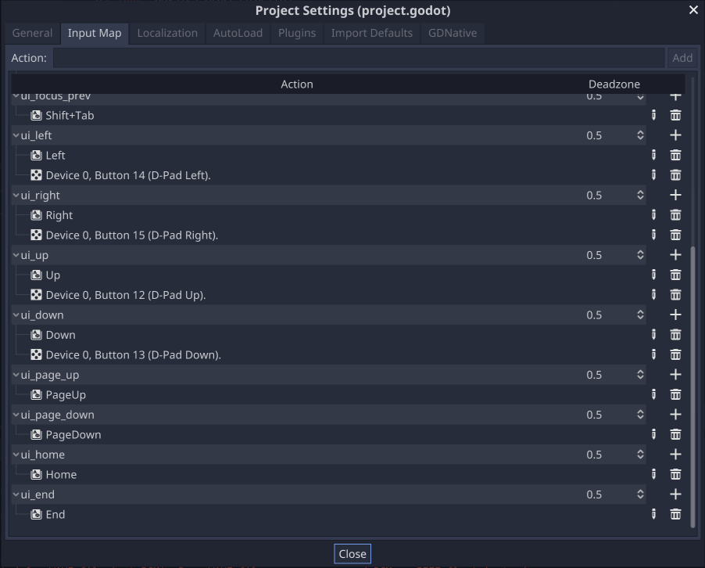
Binding Input Actions
In Project Settings:
Select the Input Map tab.
Find ”ui_left” and click the Plus sign.
Select the ”Key” option, press the “A” key to bind it, and click Ok.
Do this with the W, S, and D keys for ui_up, ui_down, and ui_right respectively.
Note: The “Key” option represents the logical input key, where “Physical Key” is the physical key location on the keyboard.

Slide 65
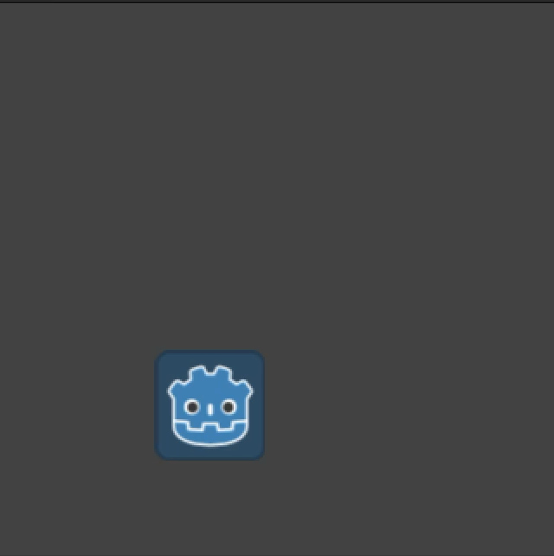
Lab Time (~10 Minutes)
Create a new Player script attached to the Player scene.
Update Input bindings in Project Settings.
Implement basic movement.
extends KinematicBody2D
var velocity = Vector2.ZERO
onready var move_speed : float = 175 * scale.x
func _physics_process(delta):
var move_left = Input.get_action_strength("ui_left")
var move_right = Input.get_action_strength("ui_right")
velocity.x = (move_right - move_left) * move_speed
var move_up = Input.get_action_strength("ui_up")
var move_down = Input.get_action_strength("ui_down")
velocity.y = (move_down - move_up) * move_speed
velocity = move_and_slide(velocity, Vector2.UP)

Slide 66
Progress Check
Where we are.
Where we want to be.

Slide 67
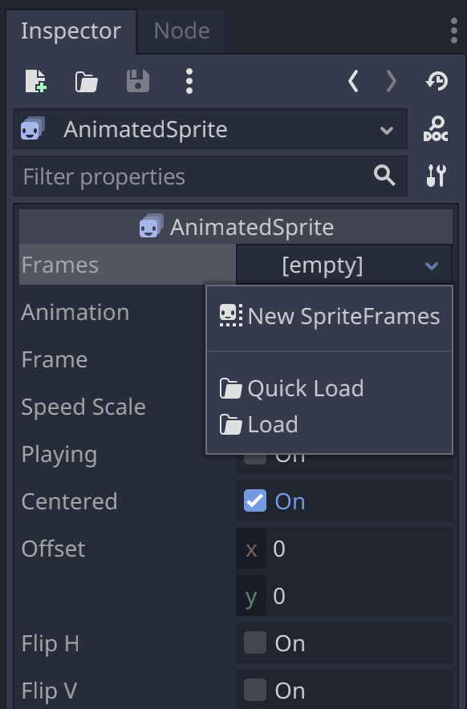
Adding Player Animations
Rename the root KinematicBody2D as “Player” (Right-Click it and find Rename).
Add a new AnimatedSprite node to the Scene (the root node).
Create a new SpriteFrames for that new AnimatedSprite node’s Frames property.

Slide 68
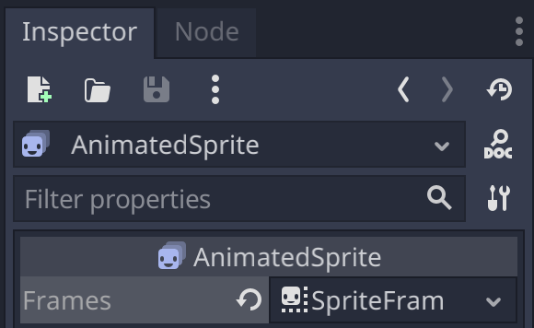
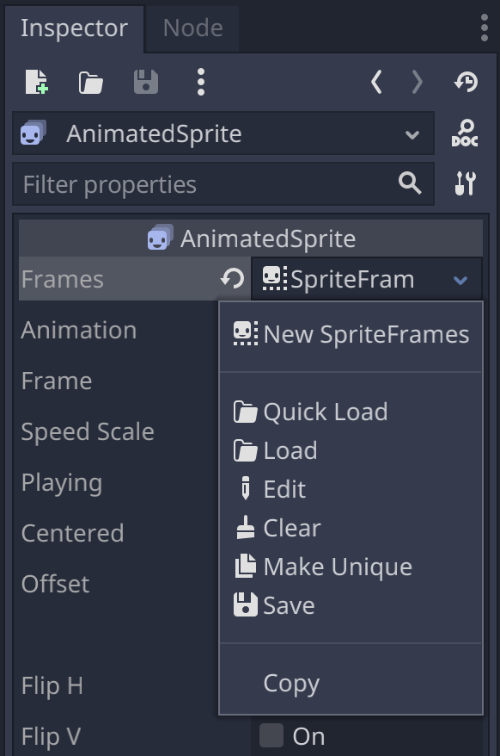
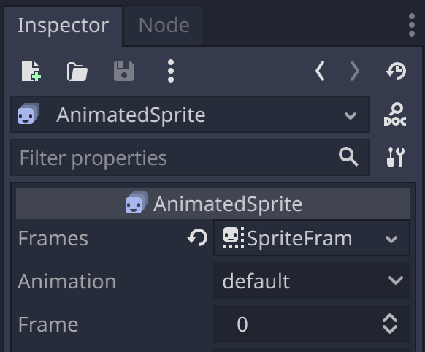
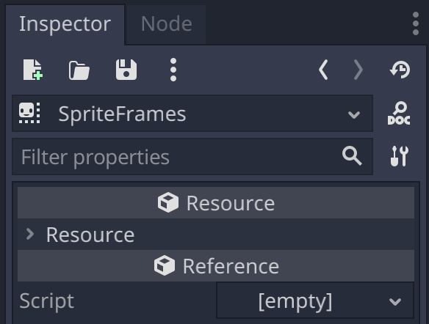
Be careful where you click!
Reset to Default
Resource Options
Change Inspector Tab Context

Slide 69
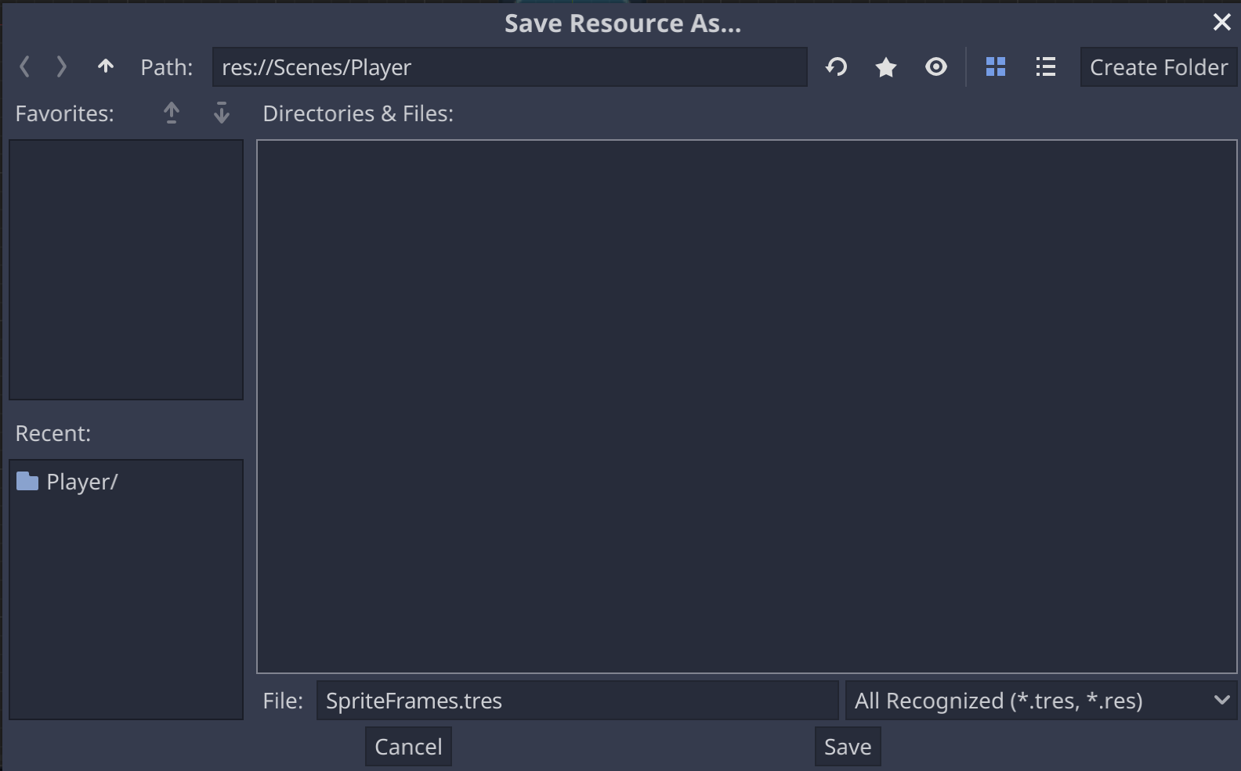
Just to be safe, save the Player SpriteFrames
If at some point you accidentally reset or wipe your Frames property, you can drag-and-drop your saved SpriteFrames resource into the Frames property value.

Slide 70

Sprites & Sprite Sheets
A Sprite Sheet is an image containing a collection (or multiple collections) of logically-grouped, equal-sized images; each individual image slice is called a Sprite.
Sprite Sheets are useful for creating 2D tilesets or animations.
Sprite Sheet
Sprite(s)

Slide 71
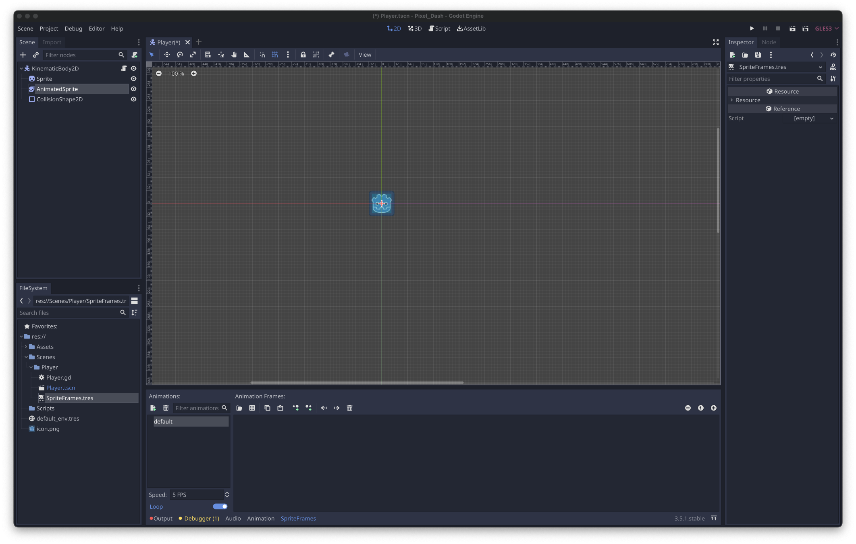

Slide 72
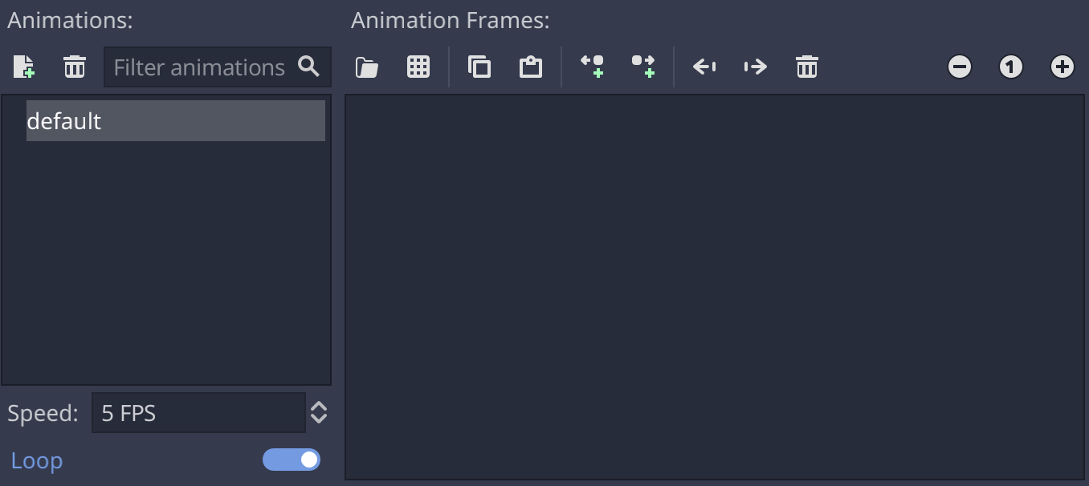
Navigating SpriteFrames
New Animation

Slide 73
Navigating SpriteFrames
Delete Selected Animation

Slide 74
Navigating SpriteFrames
Animations list

Slide 75
Navigating SpriteFrames
The run speed (frame rate) of the selected animation

Slide 76
Navigating SpriteFrames
Loop toggle (if toggled On, the animation will continuously replay once it’s finished)

Slide 77
Navigating SpriteFrames
Add Frames from a Sprite Sheet file

Slide 78
Navigating SpriteFrames
Copy/Paste for animation frames

Slide 79
Navigating SpriteFrames
Insert empty (blank) frame before/after the currently-selected frame

Slide 80
Navigating SpriteFrames
Move the currently-selected frame 1 frame to the left/right

Slide 81
Navigating SpriteFrames
Delete the currently selected frame

Slide 82
Navigating SpriteFrames
Frame view operations (Zoom Out, Reset, Zoom In)

Slide 83
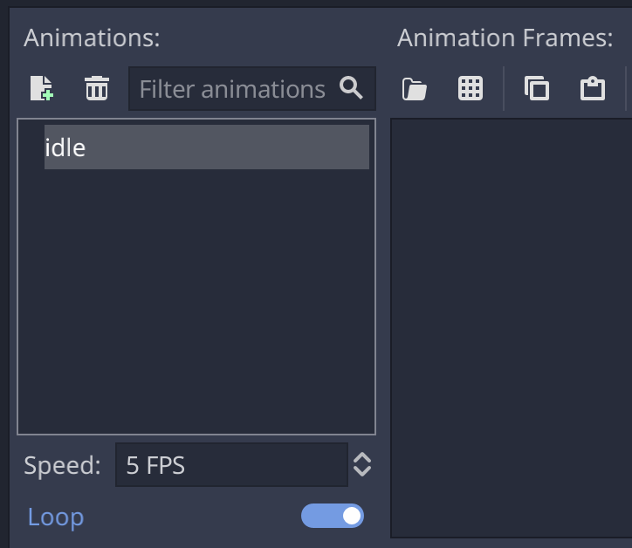
Creating the Idle Animation
Rename the “default” animation to “idle”.
Click the “Add Frames from a Sprite Sheet” button to add frames the currently selected animation.
Note: You can rename an animation by clicking an already-selected animation in the animation list.

Slide 84
Creating the Idle Animation
Open the “Idle (32x32).png” sprite sheet image from your choice of one of the four character directories. res://Assets/Art/Free/Main Characters/{CHARACTER}/Idle (32x32).png
Mask Dude
Ninja Frog
Pink Man
Virtual Guy

Slide 85


Creating the Idle Animation
Set the Frames/Sprite size to the proper dimensions.
If you don’t know the dimensions, the Horizontal & Vertical arrows are a good option for eyeballing.
If you know the size, you can set it directly in the Size fields. In our case, the width (first field) and height (second field) are both 32px.
Your sprite sheet & frames should look like this once your dimensions are set properly.

Slide 86
Creating the Idle Animation
Set the Frames/Sprite size to the proper dimensions.
If you don’t know the dimensions, the Horizontal & Vertical arrows are a good option for eyeballing.
If you know the size of your sprites, you can set it directly in the Size fields. In our case, the width (first field) and height (second field) are both 32px.
Your sprite sheet & frames should look like this once your dimensions are set properly.

Slide 87

Creating the Idle Animation
Once your dimensions are set, you then select which frames you want to add to the animation.
You can select and selected frames via left-click.
Select all frames and click the “Add 11 Frame(s)” button.
Tip: Use the top right “Select/Clear All Frames” to save on clicks!
Notice the dark background and thin blue border on each frame indicating that it is selected.

Slide 88

Creating the Idle Animation
Your animation should now have the 11 frames we selected in the previous step.
Update the Speed of the “idle” animation to be 20 FPS and keep Loop toggled “On”.

Slide 89


Test the Idle Animation
In the scene tree of your Player scene:
Delete the Sprite node.
Set the AnimatedSprite node’s “Playing” property to be toggled On.
Update the CollisionShape2D to roughly match the size of the character.
Run the scene!

Slide 90
Triggering Player Animations
In the Player script, add this code after the move_and_slide(…) call in the _physics_process func.
You can reference scene tree nodes by using a $ symbol followed by the full node path in the scene tree.
On the AnimatedSprite node, we can call the play method to play a specific animation that exists on the SpriteFrames resource.
if move_left > 0:
$AnimatedSprite.flip_h = true
elif move_right > 0:
$AnimatedSprite.flip_h = false
if velocity.y < 0:
$AnimatedSprite.play("jump")
elif velocity.y > 0:
$AnimatedSprite.play("fall")
elif velocity.x != 0:
$AnimatedSprite.play("run")
else:
$AnimatedSprite.play("idle")

Slide 91

Lab Time & Break (~15 Minutes)
Add the following 4 animations to your character:
fall
jump
idle
run
Ensure that the idle and run animations are set to Loop and have a Speed value of 20 FPS!
Update the Player script with the code from the previous slide.

Slide 92

Session Goal #2: Reusable Base Level
☑️ Controllable Player
Reusable Base Level
Player & Level Polish (Camera, Gravity, Sound, Background)
Level Checkpoints
Hazards & Player Respawn
Collectibles & HUD
A Basic Enemy
Main Menu & Changing Scenes
Open Workshop, Tinker Time

Slide 93


Creating a base Level Scene
We can’t easily add ground or platforms to the Player, since they would move with the Player.
Create a New Scene via the Scene menu.
Use Node2D as the root node for our new Scene.
Rename this new Scene’s Node2D root node as “Level”.

Slide 94


Creating a base Level Scene
Add some new nodes mimicking the structure shown to the right and rename them as shown.
Make sure the World and Ground nodes are nested child nodes, not siblings!
On the Ground TileMap node, set the Cell Size property to be 16x16 instead of 64x64 (in the Inspector window).
Set the Tile Set property to be a New Tileset. Once created, click that new value and save the TileSet (similar to what we did for the AnimatedSprite).

Slide 95


Tiles, TileSets, & TileMaps
A Tile is a single image (a sprite) representing something in the game.
A TileSet is a library of Tiles (like a logical sprite sheet) to be used in a TileMap.
You draw the Tiles from one or more TileSets onto a TileMap.
TileSet
TileMap

Slide 96


Creating the Level’s Borders TileSet
Drag the following file (from the FileSystem tab) into the dark blue box at the bottom of the screen:
res://Assets/Art/Free/Terrain/Terrain (16x16).png

Slide 97


Slide 98

TileSet Textures (sprite sheets) List

Slide 99
Add/Delete Texture

Slide 100
TileSet Editor Area

Slide 101
Zoom Out, Reset, Zoom In Buttons

Slide 102
“New Tile” Buttons

Slide 103
We will only be creating Autotiles today!

Slide 104

AutoTiles and Bitmasks
An Autotile is a tile that is configured to style itself based on the presence of neighbor tiles.
A Bitmask (in the context of a TileSet) is a grid-based “on/off” map identifying which tile should display in each scenario.
Use this tile when it’s surrounded by neighbors.

Slide 105
AutoTiles and Bitmasks
An Autotile is a tile that is configured to style itself based on the presence of neighbor tiles.
A Bitmask (in the context of a TileSet) is a grid-based “on/off” map identifying which tile should display in each scenario.
Use this tile when it has all 3 neighbors in its top-left corner (top, top-left, and left).

Slide 106
Setting up an Autotile can be tricky!
To create a new AutoTile:
Click “New Autotile”.
Toggle on “Snap to Grid” and select any square in the sprite sheet.
In the TileSet properties (in the right Inspector tab), update the Step and Subtile Size properties (x and y) to all be 16.
In the TileSet editor area, reselect an entire AutoTile “section” by dragging left-click.

Slide 107

Setting up an Autotile can be tricky!
To create a new AutoTile:
Click “New Autotile”.
Toggle on “Snap to Grid” and select any square in the sprite sheet.
In the TileSet properties (in the right Inspector tab), update the Step and Subtile Size properties (x and y) to all be 16.
In the TileSet editor area, reselect an entire AutoTile “section” by dragging left-click.

Slide 108

Setting up an Autotile can be tricky!
To create a new AutoTile:
Click “New Autotile”.
Toggle on “Snap to Grid” and select any square in the sprite sheet.
In the TileSet properties (in the right Inspector tab), update the Step and Subtile Size properties (x and y) to all be 16.
In the TileSet editor area, reselect an entire AutoTile “section” by dragging left-click.
=> 16
=> 16

Slide 109

Setting up an Autotile can be tricky!
To create a new AutoTile:
Click “New Autotile”.
Toggle on “Snap to Grid” and select any square in the sprite sheet.
In the TileSet properties (in the right Inspector tab), update the Step and Subtile Size properties (x and y) to all be 16.
In the TileSet editor area, reselect an entire AutoTile “section” by dragging left-click.
The subtle green outline highlights your current selection.

Slide 110

Defining the Autotile Bitmask
Select the Bitmask tab.
Using left/right click to toggle the masks on/off respectively, create the Bitmask as seen to the right.
Create a new Autotile for all 3 of the “wall” sprites in the left column (a total of 3 autotiles)
Warning: You can redraw the Region at any time while the Region tab is active - be careful where you click!
(Mac Users: Press Shift + Cmd if you’re seeing a blue checker pattern instead of red squares)

Slide 111
Defining the Autotile Bitmask
Select the Bitmask tab.
Using left/right click to toggle the masks on/off respectively, create the Bitmask as seen to the right.
Create a new Autotile for all 3 of the “wall” sprites in the left column (a total of 3 autotiles)
Warning: You can redraw the Region at any time while the Region tab is active - be careful where you click!
(Mac Users: Press Shift + Cmd if you’re seeing a blue checker pattern instead of red squares)

Slide 112
Defining the Autotile Bitmask
Use these arrows to navigate between tiles and autotiles.
Select the Bitmask tab.
Using left/right click to toggle the masks on/off respectively, create the Bitmask as seen to the right.
Create a new Autotile for all 3 of the “wall” sprites in the left column (a total of 3 autotiles)
Warning: You can redraw the Region at any time while the Region tab is active - be careful where you click!
(Mac Users: Press Shift + Cmd if you’re seeing a blue checker pattern instead of red squares)

Slide 113

Adding Collision to the autotiles
Select the Collision tab.
Select a tile you want to add collision to.
Select which collision shape you want to add (use the rectangle shape).
Click in the selected shape again to create the full shape.
Do this for each individual tile on all three autotiles.

Slide 114


You should see green lines around all three autotiles.
You should see three tiles on the right when you select the TileMap node in your Scene Tree.

Slide 115
Your tiles will automatically draw themselves; DO NOT rotate or shift your tiles!
You should see green lines around all three autotiles.
You should see three tiles on the right when you select the TileMap node in your Scene Tree.

Slide 116

Drawing Your Tiles
Draw
Fill
With your TileMap selected:
Select one of the tiles on the right of the screen.
Left-click to draw your tiles in the scene.
Right-click to remove a tile.
Your tiles should automatically update as they’re drawn!
All tilemap tiles are built on the same “layer”.
Pro Tip: Shift+Click to draw straight lines!

Slide 117

Instancing Child Scenes
The Instance Child Scene button allows you to instantiate a saved scene into the current scene tree.
Any changes made to a source scene will have a ripple effect in other scenes it is instanced into.
Select the root Level node.
Click the Instance Child Scene button and select the saved Player.tscn scene file.

Slide 118



Lab Time (~15 Minutes)
Create a new Level scene.
Create the three Ground autotiles, all with proper bitmasks and collision.
Instance in the Player scene as a child node of the Level scene.
Draw a small level & run!
Draw all tiles to the bottom-right of the center-point (0,0) of the Level scene!

Slide 119

Session Goal #3: Player & Level Polish
☑️ Controllable Player
☑️ Reusable Base Level
Player & Level Polish (Camera, Gravity, Sound, Background)
Level Checkpoints
Hazards & Player Respawn
Collectibles & HUD
A Basic Enemy
Main Menu & Changing Scenes
Open Workshop, Tinker Time

Slide 120
Create a Camera that Follows the Player
Add a Camera2D node as child of your instanced Player scene node in your Level scene.
A Camera Zoom value of 1 or less will zoom in, where a value above 1 will zoom out.
Limit sets the screen boundaries that your camera will not extend beyond.
Update the Camera2D Properties
Camera2D:
Current: ✅ On
Zoom: x = 0.5, y = 0.5
Limit:
Left: 0 Top: 0
Right: 1024 Bottom: 768
Editor:
Draw Limits: ✅ On

Slide 121
Add Gravity & Jump to the Player Scene
const GRAVITY = 25
const JUMP_FORCE := 400
func _physics_process(delta):
# ...
# Remove move_up and move_down code, add GRAVITY
velocity.y += GRAVITY
velocity = move_and_slide(velocity, Vector2.UP)
func _input(event):
if event.is_action_pressed("ui_accept") and is_on_floor():
velocity.y -= JUMP_FORCE

Slide 122

Add a Background to the Level Scene
The ”Background” texture node must be the first child, because nodes are drawn into the viewport from top to bottom.
Add a TextureRect node as an immediate child of Level and name it “Background”.
Set the Background’s Stretch Mode to ”Tile” & Rect Size to 1024x768.
Set the Texture property to any of the images from the Background assets folder.
res://Assets/Art/Free/Background

Slide 123

Locking Nodes
You can lock a selected node by clicking the lock icon seen to the right.
Locking the node prevents the node from being selectable in the 2D scene view.

Slide 124
Adding a Jump Sound Effect
In your Player Scene:
Add an AudioStreamPlayer node named “JumpSound” as a child of the root node.
Set the JumpSound’s Stream property to be the Jump 1.wav file (drag and drop).
res://Assets/Audio/jdwasabi_Sounds/Jump 1.wav
Update the Player script to call $JumpSound.play() where we trigger our jump in the _input(event) function.
Note: An AudioStreamPlayer2D node can be used to play 2D-spatial audio.

Slide 125
Lab Time (~10 Minutes)
Add a Level background.
Add a following camera to the Player in the Level scene.
Add Gravity & Jump behavior to the Player script.
Add a Jump sound to the Player.
[Optional] Add music to the Level.

Slide 126

Session Goal #4: Level Checkpoints
✅ Controllable Player
✅ Reusable Base Level
✅ Player & Level Polish (Camera, Gravity, Sound, Background)
Level Checkpoints
Hazards & Player Respawn
Collectibles & HUD
A Basic Enemy
Main Menu & Changing Scenes
Open Workshop, Tinker Time

Slide 127
Adding Level Checkpoints
Create a new Area2D scene and name the root node “Checkpoint”.
Add an AnimatedSprite child node and create three new 20 FPS sprite animations (idle, activating, active) using the (No Flag, Flag Out, Flag Idle) sprite sheets from following directory: Assets/Art/Free/Items/Checkpoints/Checkpoint
Position the sprite so the center of the scene sits to the middle-right of the pole.
Save the Checkpoint scene. Also save the AnimatedSprite as a resource for safety.

Slide 128

Adding Level Checkpoints
Set the AnimatedSprite’s Playing property to “On” and set the Animation property to the “idle” animation.
Set all animations to be 20 FPS and set the activating animation to not loop.
Add a CollisionShape2D child to the root Checkpoint node and give it a rectangle shape that encompasses the shape of the flagpole.

Slide 129
Create a Checkpoint Script
extends Area2D
# optional “setget” keyword = set_func[, get_func] export (bool) var is_active := false setget set_active
func set_active(new_value):
is_active = new_value
if is_active:
$AnimatedSprite.play("activating")
else:
# second arg is an optional “play backwards” flag $AnimatedSprite.play("activating", true)
export – makes the value accessible for editing in the Inspector tab

Slide 130
Intro to Signals
“Call down, Signal up”
Signals are messages that nodes can emit when something specific has happened (such as a button being pressed, or an area being entered).
Other nodes or scripts can connect to and listen for specific signals, allowing those components to react when the signals are emitted.
You can connect signals via either the Node tab (to the right of the Inspector tab) or directly through code.

Slide 131
Order of Events
The Player scene’s KinematicBody2D will collide with (or enter) the Checkpoint scene’s Area2D.
The Checkpoint’s Area2D node (the root node type) will emit a signal that a collision has occurred.
The Checkpoint script will respond to the event by attempting to call the triggering colliding body’s update_checkpoint function if the colliding body has that function (intended for the Player).
The Player will update its own checkpoint references for future use in respawn behavior via its own update_checkpoint function.

Slide 132

Adding Level Checkpoints
Select your Checkpoint scene’s Area2D root node in the Scene Tree.
Switch from the Inspector tab to the Node tab.
Connect the Area2D body_entered signal to the Checkpoint script by double-clicking that signal name.

Slide 133

Adding Level Checkpoints
This dialog is prompting for which node/script you want to connect to listen for event emissions from the Area2D’s body_entered signal.
The result of this dialog is a generated event handler callback function for the selected event.
Keep the defaults and click the connect button.

Slide 134

Adding Level Checkpoints
Add this basic code to the empty generated callback function.
Notice the status icon in the left gutter of the same line as the signal callback function. This only happens on signals connected through the Node tab.
The “update_checkpoint” function will be added to the Player script soon.

Slide 135
Adding Level Checkpoints
Do the same kind of signal wiring for the Checkpoint scene’s AnimatedSprite’s animation_finished signal.
func _on_AnimatedSprite_animation_finished():
if is_active:
$AnimatedSprite.play("active")
else:
$AnimatedSprite.play("idle")

Slide 136
Update the Player to Use Checkpoints
var respawn_checkpoint_node_ref : Node2D
func update_checkpoint(new_checkpoint: Node2D):
if respawn_checkpoint_node_ref == new_checkpoint:
return
if respawn_checkpoint_node_ref != null:
respawn_checkpoint_node_ref.set_active(false)
respawn_checkpoint_node_ref = new_checkpoint
respawn_checkpoint_node_ref.set_active(true)

Slide 137
Add Checkpoints to the Level Scene
In your Level scene, add a new Node child named Checkpoints. Make sure this new node is between the World and Player scenes in the scene tree.
With the Checkpoints node selected, instance in a Checkpoint scene.
Put the Checkpoint somewhere other than the Player’s starting point.
Duplicate the Checkpoint (right-click the scene node and select the “Duplicate” option from the context menu) and move it to a different location in the level.
Run the game and walk to the flags!

Slide 138
Lab Time & Break (~15 Minutes)
Create the Checkpoint scene.
Create the Checkpoint script and set up signal handlers.
Update the Player script to have a basic checkpoint implementation.
Instance some Checkpoint scenes into the Level scene.

Slide 139

Session Goal #5: Hazards & Player Respawn
✅ Controllable Player
✅ Reusable Base Level
✅ Player & Level Polish (Camera, Gravity, Sound, Background)
✅ Level Checkpoints
Hazards & Player Respawn
Collectibles & HUD
A Basic Enemy
Main Menu & Changing Scenes
Open Workshop, Tinker Time

Slide 140

Creating a Spikes Scene
Create a new Area2D scene and rename it “Spikes”.
Add a child Sprite node and set its Texture property to: Assets/Art/Free/Traps/Spikes/Idle.png
Align the Sprite so the spikes appear above the center (0,0) of the scene.
Notice the Spike scene’s center (0,0) position

Slide 141

Creating a Spikes Scene
Add a CollisionPolygon2D node as a child of the Spikes root node.
Click the “Create Points” button left-click parts of the boundary one-by-one to produce a shape.
Close the polygon by adding a second point on the starting point.
Tip: Turn off Grid Snapping if you want a pixel-perfect shape.

Slide 142
Emit the Spikes “Damage” Signal
Create a new Spikes script on the root node of the Spikes scene.
Connect the Area2D body_entered signal to the new Spikes script using the same has_method strategy used in the Checkpoint scene.
extends Area2D
func _on_Spikes_body_entered(body):
if body.has_method("take_spike_damage"):
body.take_spike_damage()

Slide 143
Update the Player to Respond to Spikes
Add the following code to the Player script.
onready var START_POSITION = global_position
func take_spike_damage() -> void:
respawn()
func respawn():
if respawn_checkpoint_node_ref != null:
global_position = START_POSITION
else:
global_position = respawn_checkpoint_node_ref.global_position

Slide 144
Update the Player to Respond to Spikes
Add the following code to the Player script.
The START_POSITION var is a default position to avoid null checkpoint refs.
onready var START_POSITION = global_position
func take_spike_damage() -> void:
respawn()
func respawn():
if respawn_checkpoint_node_ref != null:
global_position = START_POSITION
else:
global_position = respawn_checkpoint_node_ref.global_position

Slide 145
Update the Player to Respond to Spikes
Add the following code to the Player script.
The take_spike_damage func is called by the Spikes to trigger a respawn.
onready var START_POSITION = global_position
func take_spike_damage() -> void:
respawn()
func respawn():
if respawn_checkpoint_node_ref != null:
global_position = START_POSITION
else:
global_position = respawn_checkpoint_node_ref.global_position

Slide 146
Update the Player to Respond to Spikes
Add the following code to the Player script.
The respawn func safely moves our player back to the current “checkpoint”.
onready var START_POSITION = global_position
func take_spike_damage() -> void:
respawn()
func respawn():
if respawn_checkpoint_node_ref != null:
global_position = START_POSITION
else:
global_position = respawn_checkpoint_node_ref.global_position

Slide 147
Lab Time & Break (~10 Minutes)
Create the Spikes scene and script, with the Area2D signal callbacks.
Create a new “Hazards” Node as an immediate sibling of the Checkpoints node.
Instantiate some Spikes scenes into the new Hazards node.
Verify the Damage & Respawn behavior works by jumping on Spikes.

Slide 148

Session Goal #6: Collectibles & HUD
✅ Controllable Player
✅ Reusable Base Level
✅ Player & Level Polish (Camera, Gravity, Sound, Background)
✅ Level Checkpoints
✅ Hazards & Player Respawn
Collectibles & HUD
A Basic Enemy
Main Menu & Changing Scenes
Open Workshop, Tinker Time

Slide 149

Creating a Fruit Scene
Create a new Area2D scene named “Fruit” with the same scene tree structure seen to the right.
Create a new SpriteFrames resource for the AnimatedSprite’s Frames property.
Create two new animations using any two of the sprite sheets at the following path: Assets/Art/Free/Items/Fruits/

Slide 150

Creating some animated Fruits
Create two new appropriately-named animations using any two of the sprite sheets at the following path: Assets/Art/Free/Items/Fruits/
Create a third animation called “poof” on the same SpriteFrames resource using the Collected.png file from the same directory as above.
Make sure all animations are 20 FPS, and that “poof” is the only animation with Loop turned off.

Slide 151

Fruit Collision and Collection Sound
Apply a Circle shape to the CollisionShape2D and set the size of the circle to encompass the sprite.
Update the AudioStreamPlayer Stream property to be the “Fruit collect 1” wav sound from the sounds folder:
Assets/Audio/jdwasabi_Sounds/

Slide 152
Create a Fruit Script and Connect Signals
extends Area2D
export (String, "Banana", "Strawberry") var fruit = "Banana" setget set_fruit
onready var ANIMATED_SPRITE := $AnimatedSprite
func set_fruit(new_value:String):
fruit = new_value
$AnimatedSprite.play(fruit.to_lower())
func _on_Fruit_body_entered(body):
if visible and body.has_method("collect_fruit"):
body.collect_fruit(fruit.to_lower())
ANIMATED_SPRITE.play("poof")
$AudioStreamPlayer.play()
func _on_AnimatedSprite_animation_finished():
if $AnimatedSprite.animation == "poof": visible = false

Slide 153
Create a Fruit Script and Connect Signals
The export keyword makes the variable available for editing in instanced child nodes in the Inspector window.
extends Area2D
export (String, "Banana", "Strawberry") var fruit = "Banana" setget set_fruit
onready var ANIMATED_SPRITE := $AnimatedSprite
func set_fruit(new_value:String):
fruit = new_value
$AnimatedSprite.play(fruit.to_lower())
func _on_Fruit_body_entered(body):
if visible and body.has_method("collect_fruit"):
body.collect_fruit(fruit.to_lower())
ANIMATED_SPRITE.play("poof")
$AudioStreamPlayer.play()
func _on_AnimatedSprite_animation_finished():
if $AnimatedSprite.animation == "poof": visible = false

Slide 154
Create a Fruit Script and Connect Signals
Creating an onready variable that references a named node in the Scene Tree ($ syntax) makes maintenance easier.
extends Area2D
export (String, "Banana", "Strawberry") var fruit = "Banana" setget set_fruit
onready var ANIMATED_SPRITE := $AnimatedSprite
func set_fruit(new_value:String):
fruit = new_value
$AnimatedSprite.play(fruit.to_lower())
func _on_Fruit_body_entered(body):
if visible and body.has_method("collect_fruit"):
body.collect_fruit(fruit.to_lower())
ANIMATED_SPRITE.play("poof")
$AudioStreamPlayer.play()
func _on_AnimatedSprite_animation_finished():
if $AnimatedSprite.animation == "poof": visible = false

Slide 155
Create a Fruit Script and Connect Signals
Update the internal value of the fruit variable and run the animation the same name when the setter is called.
extends Area2D
export (String, "Banana", "Strawberry") var fruit = "Banana" setget set_fruit
onready var ANIMATED_SPRITE := $AnimatedSprite
func set_fruit(new_value:String):
fruit = new_value
$AnimatedSprite.play(fruit.to_lower())
func _on_Fruit_body_entered(body):
if visible and body.has_method("collect_fruit"):
body.collect_fruit(fruit.to_lower())
ANIMATED_SPRITE.play("poof")
$AudioStreamPlayer.play()
func _on_AnimatedSprite_animation_finished():
if $AnimatedSprite.animation == "poof": visible = false

Slide 156
Create a Fruit Script and Connect Signals
Play an animation, sound, and call a method against a valid triggering/colliding body against the Area2D collision body.
extends Area2D
export (String, "Banana", "Strawberry") var fruit = "Banana" setget set_fruit
onready var ANIMATED_SPRITE := $AnimatedSprite
func set_fruit(new_value:String):
fruit = new_value
$AnimatedSprite.play(fruit.to_lower())
func _on_Fruit_body_entered(body):
if visible and body.has_method("collect_fruit"):
body.collect_fruit(fruit.to_lower())
ANIMATED_SPRITE.play("poof")
$AudioStreamPlayer.play()
func _on_AnimatedSprite_animation_finished():
if $AnimatedSprite.animation == "poof": visible = false

Slide 157
Create a Fruit Script and Connect Signals
When the AnimatedSprite finishes playing the “poof” animation, make this Fruit scene invisible.
extends Area2D
export (String, "Banana", "Strawberry") var fruit = "Banana" setget set_fruit
onready var ANIMATED_SPRITE := $AnimatedSprite
func set_fruit(new_value:String):
fruit = new_value
$AnimatedSprite.play(fruit.to_lower())
func _on_Fruit_body_entered(body):
if visible and body.has_method("collect_fruit"):
body.collect_fruit(fruit.to_lower())
ANIMATED_SPRITE.play("poof")
$AudioStreamPlayer.play()
func _on_AnimatedSprite_animation_finished():
if $AnimatedSprite.animation == "poof": visible = false

Slide 158
Create a Fruit Script and Connect Signals
Note the use of $AnimatedSprite instead of ANIMATED_SPRITE (to avoid impending Nil reference errors).
extends Area2D
export (String, "Banana", "Strawberry") var fruit = "Banana" setget set_fruit
onready var ANIMATED_SPRITE := $AnimatedSprite
func set_fruit(new_value:String):
fruit = new_value
$AnimatedSprite.play(fruit.to_lower())
func _on_Fruit_body_entered(body):
if visible and body.has_method("collect_fruit"):
body.collect_fruit(fruit.to_lower())
ANIMATED_SPRITE.play("poof")
$AudioStreamPlayer.play()
func _on_AnimatedSprite_animation_finished():
if $AnimatedSprite.animation == "poof": visible = false

Slide 159

The export keyword makes the variable available for editing in instanced child nodes in the Inspector window.
However, changing the value in the Inspector does not update the animation of the Fruit scene(s) in the editor.

Slide 160
Update the Fruit script to be a “tool”
Add the tool keyword to the very beginning of a Script to have the script/scene run in the editor the same way it would run in-game.
tool extends Area2D
export (String, "Banana", "Strawberry") var fruit = "Banana" setget set_fruit
onready var ANIMATED_SPRITE := $AnimatedSprite
func set_fruit(new_value:String):
fruit = new_value
$AnimatedSprite.play(fruit.to_lower())
# ...
func _on_AnimatedSprite_animation_finished():
if $AnimatedSprite.animation == "poof":
visible = false

Slide 161

With the tool keyword on our Fruit script and the new setter function, we can see the Fruit animation update in the editor whenever we change the value of the Fruit variable. This will also work if you change the fruit value in-game!

Slide 162
Update the Player to Handle Fruit Collection
The collected_fruit variable is a Dictionary type, which very much resembles and behaves like a Map or JSON object.
var collected_fruit := {}
func collect_fruit(fruit:String) -> void:
if not collected_fruit.has(fruit):
collected_fruit[fruit] = 0
collected_fruit[fruit] += 1

Slide 163


Lab Time (~15 Minutes)
Create the Fruit scene with at least two different types of fruit available.
Create a new Node named “Collectibles” in your Level scene tree as a sibling of the Hazards node.
Instance in some Fruit nodes as children of the Collectibles node, and scatter them around.

Slide 164

Creating a HUD/UI using a CanvasLayer
A HUD (heads-up display) is a UI tool used for providing useful game information to the player.
Most HUD elements are overlays that are not intended to be directly interacted with.
Each Godot CanvasLayer is a separate 2D rendering layer. We can use CanvasLayers to draw these static UI elements on the screen.

Slide 165


Godot CanvasLayer & Control Nodes
CanvasLayer nodes are UI/drawing layers that are independent of scene tree order. These nodes are drawn depending only on their layer number, so they can be instantiated whenever/however needed.

Slide 166
Godot CanvasLayer & Control Nodes
The Control node is the base class/node for all UI-related nodes. It has features allowing it to be positioned relative to its parent control or the current viewport (including screen size changes).

Slide 167

Creating a HUD
Create a new scene using a CanvasLayer as the root node.
Add a bunch of new nodes mimicking the scene tree structure seen to the right.
Rename the CanvasLayer root node to “HUD” and save it with the same name.
Update the Transform > Scale property to “2” for x and y (to make the HUD twice as large).
Intended HUD Structure

Slide 168
A Quick Look at the Control Nodes
An HBoxContainer (Horizontal) is a container that allows us to simply align items horizontally.
A VBoxContainer (Vertical) is like an HBoxContainer, except it behaves vertically.
A Control lets us group related components.
A TextureRect is a rectangle that can have a texture applied to it.
A Label displays plain text.

Slide 169
A Quick Look at the Control Nodes
An HBoxContainer (Horizontal) is a container that allows us to simply align items horizontally.
A VBoxContainer (Vertical) is like an HBoxContainer, except it behaves vertically.
A Control lets us group related components.
A TextureRect is a rectangle that can have a texture applied to it.
A Label displays plain text.

Slide 170
A Quick Look at the Control Nodes
An HBoxContainer (Horizontal) is a container that allows us to simply align items horizontally.
A VBoxContainer (Vertical) is like an HBoxContainer, except it behaves vertically.
A Control lets us group related components.
A TextureRect is a rectangle that can have a texture applied to it.
A Label displays plain text.

Slide 171
A Quick Look at the Control Nodes
An HBoxContainer (Horizontal) is a container that allows us to simply align items horizontally.
A VBoxContainer (Vertical) is like an HBoxContainer, except it behaves vertically.
A Control lets us group related components.
A TextureRect is a rectangle that can have a texture applied to it.
A Label displays plain text.

Slide 172
A Quick Look at the Control Nodes
An HBoxContainer (Horizontal) is a container that allows us to simply align items horizontally.
A VBoxContainer (Vertical) is like an HBoxContainer, except it behaves vertically.
A Control lets us group related components.
A TextureRect is a rectangle that can have a texture applied to it.
A Label displays plain text.

Slide 173

Creating a HUD: HBoxContainer
With the CanvasLayer “HUD” node selected in your scene tree:
Set the Layout to Top Wide, which will cause the HUD to stretch across the the width of the screen/viewport.
In the Inspector, update the Margin > Left to be 8 and the Rect > Size > y to be 48.
Set the Theme Overrides > Constants > Separation to 16 for gap spacing.

Slide 174

Creating a HUD: VBoxContainer
With the first VBoxContainer selected in the HUD scene tree:
Update its name to be {Fruit}VBox for one of your chosen fruits (e.g., BananaVBox if you chose Banana as one of your collectibles).

Slide 175

Creating a HUD: Control
With the Control of the first FruitVBox selected in the HUD scene tree:
Set its Rect > Min Size to be 32 for the x and y properties.
Set the Rect > Clip Content to On; this will prevent overflow content from displaying.

Slide 176

Creating a HUD: TextureRect
With the TextureRect of the Control selected in the HUD scene tree:
Set its Texture to be the same Fruit.png file used for the AnimatedSprite of the fruit being represented.
Since it’s such a wide image, lock the TextureRect in the editor window out of caution.

Slide 177


Creating a HUD: Label
With the Label of the first FruitVBox selected in the HUD scene tree:
Set its Text to “00/00” for some simple testing.
Set Align and V Align to “Center”.
Under the Theme Overrides section, create a new Normal StyleBoxFlat value and give it some basic styling as seen to the far right.

Slide 178


Creating a HUD: Repeat for Fruit #2
Rinse-and-repeat the same process for your second fruit.
Note: You should have two VBoxContainer nodes and only one HBoxContainer.

Slide 179


Lab Time (~15 Minutes)
Create the HUD scene.
Instance in the HUD scene as a child node in the Level scene.

Slide 180

Creating a Signal Chain from Player to HUD
The Player & HUD exist within the Level, but all have inter-communication needs. We need to cater to those needs without breaking the appropriate abstractions.
LEVEL
HUD
PLAYER

Slide 181
Creating a Signal Chain from Player to HUD
HUD, please update your labels when the Player says it collected fruit.
1) When the Level finishes loading, the Level tells its HUD child to listen for specific signals emitted by its Player child.
LEVEL
HUD
PLAYER

Slide 182

Creating a Signal Chain from Player to HUD
2) When the Player collects a Fruit, the Player will emit a specific signal indicating that event has occurred.
“I now have one banana!”
LEVEL
HUD
PLAYER

Slide 183



Creating a Signal Chain from Player to HUD
“One banana” heard! Updating my labels.
3) The HUD reacts to the observed signal by updating its fruit labels with the info provided with the signal.
LEVEL
HUD
PLAYER

Slide 184
Creating a HUD: Emit a Signal from Player
Since the Player is trigging the event, the Player script needs to be updated to emit an appropriate Signal.
extends KinematicBody2D
signal fruit_collected
# ...
func collect_fruit(fruit:String) -> void:
if not collected_fruit.has(fruit):
collected_fruit[fruit] = 0
collected_fruit[fruit] += 1
emit_signal("fruit_collected", collected_fruit)

Slide 185
Creating a HUD: Emit a Signal from Player
This line defines a new “fruit_collected” signal that can be emitted from/by the Player.
extends KinematicBody2D
signal fruit_collected
# ...
func collect_fruit(fruit:String) -> void:
if not collected_fruit.has(fruit):
collected_fruit[fruit] = 0
collected_fruit[fruit] += 1
emit_signal("fruit_collected", collected_fruit)

Slide 186
Creating a HUD: Emit a Signal from Player
Update the Player’s collect_fruit function to emit the new signal, providing the collected_fruit dictionary variable as extra data for listeners/observers to process.
extends KinematicBody2D
signal fruit_collected
# ...
func collect_fruit(fruit:String) -> void:
if not collected_fruit.has(fruit):
collected_fruit[fruit] = 0
collected_fruit[fruit] += 1
emit_signal("fruit_collected", collected_fruit)

Slide 187
Creating a HUD: Add HUD Update Behavior
We need a way to tell the HUD to update the Fruit count labels, so we need to create a HUD script.
Tip: You can drag-and-drop a node from the scene tree into a Script to use its relative path.
extends CanvasLayer
onready var bananaLabel = $HBoxContainer/BananaVBox/Label
onready var strawberryLabel = $HBoxContainer/StrawberryVBox/Label
onready var fruit_totals := {
"banana": { "current": 0, "total": 0, "labelNode": bananaLabel },
"strawberry": { "current": 0, "total": 0, "labelNode": strawberryLabel }
}

Slide 188
Creating a HUD: Add HUD Update Behavior
We first need a reference to the label node in the Scene tree for each fruit.
Tip: You can drag-and-drop a node from the scene tree into a Script for easy access to the node’s relative path.
extends CanvasLayer
onready var bananaLabel = $HBoxContainer/BananaVBox/Label
onready var strawberryLabel = $HBoxContainer/StrawberryVBox/Label
onready var fruit_totals := {
"banana": { "current": 0, "total": 0, "labelNode": bananaLabel },
"strawberry": { "current": 0, "total": 0, "labelNode": strawberryLabel }
}

Slide 189
Creating a HUD: Add HUD Update Behavior
We then initialize our fruit data with a current and total value.
We also store each fruit’s node reference for easy updating (to avoid dynamic node lookups in the scene tree).
extends CanvasLayer
onready var bananaLabel = $HBoxContainer/BananaVBox/Label
onready var strawberryLabel = $HBoxContainer/StrawberryVBox/Label
onready var fruit_totals := {
"banana": { "current": 0, "total": 0, "labelNode": bananaLabel },
"strawberry": { "current": 0, "total": 0, "labelNode": strawberryLabel }
}

Slide 190
Creating a HUD: Add HUD Update Behavior
Then we create some functions to facilitate updating the current values (the fruit dictionary provided by the Player signal) as well as increasing the total fruit count (called by the Level on start/ready).
func update_current_fruit(fruit_data:Dictionary) -> void:
for fruit in fruit_data.keys():
fruit_totals.get(fruit).current = fruit_data.get(fruit)
update_labels()
func increase_fruit_max(fruit:String) -> void:
fruit_totals.get(fruit.to_lower()).total += 1
update_labels()
func update_labels():
for fruit_value in fruit_totals.values():
var fruit_label = "%d/%d" % [fruit_value.current, fruit_value.total]
fruit_value.labelNode.text = fruit_label

Slide 191
Creating a HUD: Add HUD Update Behavior
And finally, a function to update our fruit labels when any of the current or total fruit counts change.
func update_current_fruit(fruit_data:Dictionary) -> void:
for fruit in fruit_data.keys():
fruit_totals.get(fruit).current = fruit_data.get(fruit)
update_labels()
func increase_fruit_max(fruit:String) -> void:
fruit_totals.get(fruit.to_lower()).total += 1
update_labels()
func update_labels():
for fruit_value in fruit_totals.values():
var fruit_label = "%d/%d" % [fruit_value.current, fruit_value.total]
fruit_value.labelNode.text = fruit_label

Slide 192
Creating a HUD: Connect Signals via the Level
With the Player and the HUD set up to do their respective parts, it is up to the Level to set up the communication between itself and its child nodes (the HUD and the Player). This happens on the _ready() function of a new Level script.
extends Node2D
func _ready():
$Player.connect("fruit_collected", $HUD, "update_current_fruit")
for fruit_child in $Collectibles.get_children():
if fruit_child.get("fruit") != null:
$HUD.increase_fruit_max(fruit_child.fruit)

Slide 193

Creating a HUD: Make the Level a Conductor
Using the SOURCE of the signal (the Player node), we connect its “fruit_collected” signal to a target object intended to react to the signal (the HUD node) via a specific function on the target object.
extends Node2D
func _ready():
$Player.connect("fruit_collected", $HUD, "update_current_fruit")
for fruit_child in $Collectibles.get_children():
if fruit_child.get("fruit") != null:
$HUD.increase_fruit_max(fruit_child.fruit)
“HUD, please update your labels when the Player says it collected fruit.”
connect(signal: String, target: Object, method: String)

Slide 194
Creating a HUD: Make the Level a Conductor
Finally, we loop through all of the child nodes in the Collectibles node (which should only be Fruit nodes) to safely update the total fruit counts in the HUD.
extends Node2D
func _ready():
$Player.connect("fruit_collected", $HUD, "update_current_fruit")
for fruit_child in $Collectibles.get_children():
if fruit_child.get("fruit") != null:
$HUD.increase_fruit_max(fruit_child.fruit)

Slide 195
Lab Time & Break (~15 Minutes)
Update the Player script to emit a fruit_collected signal when the Player collects fruit.
Create a HUD script with functions to update the fruit labels.
Create a Level script to connect the Player signal to an appropriate HUD function to update fruit labels when fruit is collected.
Have the Level script set/increase the max fruit counts on startup.

Slide 196
Session Goal #7: A Basic Enemy
✅ Controllable Player
✅ Reusable Base Level
✅ Player & Level Polish (Camera, Gravity, Sound, Background)
✅ Level Checkpoints
✅ Hazards & Player Respawn
✅ Collectibles & HUD
A Basic Enemy
Main Menu & Changing Scenes
Open Workshop, Tinker Time

Slide 197

Create a new SnailEnemy Scene
A Scene new KinematicBody2D scene named SnailEnemy.
Mimic the scene tree structure seen to the right.
Note: You can hide the RayCast2D for now (or otherwise ignore it in the editor). We will discuss it after going over the properties of familiar nodes.

Slide 198

Add Animations and Hit Sound
Create two animations for the AnimatedSprite node (20 FPS, looping):
“defeated” Assets/Art/Pixel Adventure 2/Enemies/Snail/Walk (38x24).png
“walk” (first frame only) Assets/Art/Pixel Adventure 2/Enemies/Snail/Idle (38x24).png
Use the following sound for the HitAudioStreamPlayer “Stream” sound:
Assets/Audio/jdwasabi_Sounds/Hit damage 1.wav
Note: The AnimatedSprite should be positioned so that it is sitting on the scene’s center position.

Slide 199

Build CollisionShape2D Shapes
Mimic each of the CollisionShape2D node shapes as seen to the right for the following parent nodes:

Slide 200
Build CollisionShape2D Shapes
Mimic each of the CollisionShape2D node shapes as seen to the right for the following parent nodes:
SnailEnemy (the root node)
This collision shape will be used to keep the KinematicBody2D on the ground, much like how the Player behaves.

Slide 201
Build CollisionShape2D Shapes
Mimic each of the CollisionShape2D node shapes as seen to the right for the following parent nodes:
HitArea2D
This HitArea2D shape will be used for collision detection with the Player. Collision with this shape will trigger the Player to respawn.

Slide 202
Build CollisionShape2D Shapes
Mimic each of the CollisionShape2D node shapes as seen to the right for the following parent nodes:
ShellArea2D
This ShellArea2D will be the area that the Player can jump on to defeat the Snail.

Slide 203
Add Basic Movement to the SnailEnemy Script
Since the Snail’s sprites face left by default, we simply modify the X velocity by the negative move speed to flip it.
extends KinematicBody2D
const DEFEATED_BOUNCE_FORCE := 250 # will be used soon const GRAVITY = 25
onready var move_speed : float = 35 * scale.x
var is_alive := true # will be used soon
var velocity = Vector2.ZERO
func _physics_process(delta):
if is_alive: velocity.x = -move_speed
velocity.y += GRAVITY
velocity = move_and_slide(velocity, Vector2.UP)
if is_alive and velocity.x != 0: $AnimatedSprite.play("walk")

Slide 204

Turning Around on Collision with a Wall
The KinematicBody2D has a convenient is_on_wall() function to make this a relatively “trivial” implementation.
func _physics_process(delta):
# ...
if is_alive and is_on_wall():
turn_around()
func turn_around():
scale.x *= -1
move_speed *= -1

Slide 205
Turning Around on Collision with a Wall
The inverted X scale “horizontally flips” all nodes in the scene. The inverted move_speed changes its direction.
func _physics_process(delta):
# ...
if is_alive and is_on_wall():
turn_around()
func turn_around():
scale.x *= -1
move_speed *= -1

Slide 206

Connect SnailEnemy HitArea with the Player
SnailEnemy.gd
func _on_HitArea2D_body_entered(body):
if body.has_method("take_enemy_damage"):
body.take_enemy_damage()
Note: Don’t forget to connect the HitArea2D signal to the SnailEnemy script via the Node tab!
Player.gd
func take_enemy_damage() -> void:
respawn()
A simple duplication of take_spike_damage() for easy changes later.

Slide 207
Taking Damage from the SnailEnemy
Ultimately, we have two ways the Player can collide with a snail:
The SnailEnemy collides with the Player
The Player collides with the SnailEnemy (e.g., from behind)
The move_and_slide function stores collisions as a side effect. Collisions are only triggered by the collider, and that function will not trigger any collisions that happen outside of the slide (like from behind).
func _physics_process(delta):
# ...
velocity = move_and_slide(velocity, Vector2.UP)
for i in get_slide_count():
if get_slide_collision(i).collider.name.begins_with("SnailEnemy"):
take_enemy_damage()

Slide 208

What is a RayCast2D?
A RayCast2D represents a line from its origin to a destination point on a 2D plane.
It is used to query a 2D space in order to find the closest object along the path of the ray (if one exists).
We can use a RayCast2D to detect a ledge, so the snail can turn around and avoid falling into holes or pits.

Slide 209


Setting up the RayCast2D
Remember to make the RayCast2D node visible if you previously disabled or hid it.
Update the RayCast2D properties as seen to the right.
Notice the position and length of the RayCast2D arrow.

Slide 210

Using the RayCast2D to avoid ledges
Update the SnailEnemy to also check for a missing collision on the RayCast2D (“no collision” means “no ground”).
func _physics_process(delta):
# ...
if is_alive and velocity.x != 0: $AnimatedSprite.play("walk")
var is_wall_or_ledge = is_on_wall() or not $RayCast2D.is_colliding()
if is_alive and is_wall_or_ledge: turn_around()

Slide 211
Defeating the Snail by Bouncing On It
Remember – you get these function names by connecting to signals in the Node tab!
func _on_ShellArea2D_body_entered(body):
if is_alive:
is_alive = false
if body.has_method("bounce"): body.bounce()
set_collision_layer_bit(0, false)
set_collision_mask_bit(0, false)
$HitArea2D.set_collision_layer_bit(0, false)
$HitArea2D.set_collision_mask_bit(0, false)
$ShellArea2D.set_collision_layer_bit(0, false)
$ShellArea2D.set_collision_mask_bit(0, false)
$HitAudioStreamPlayer.play()
velocity.y -= DEFEATED_BOUNCE_FORCE
$AnimatedSprite.play("defeated")
yield(get_tree().create_timer(1), "timeout")
queue_free()

Slide 212
Defeating the Snail by Bouncing On It
Do some basic checks to determine if the Snail is alive. Immediately set is_alive to false to prevent multiple executions.
func _on_ShellArea2D_body_entered(body):
if is_alive:
is_alive = false
if body.has_method("bounce"): body.bounce()
set_collision_layer_bit(0, false)
set_collision_mask_bit(0, false)
$HitArea2D.set_collision_layer_bit(0, false)
$HitArea2D.set_collision_mask_bit(0, false)
$ShellArea2D.set_collision_layer_bit(0, false)
$ShellArea2D.set_collision_mask_bit(0, false)
$HitAudioStreamPlayer.play()
velocity.y -= DEFEATED_BOUNCE_FORCE
$AnimatedSprite.play("defeated")
yield(get_tree().create_timer(1), "timeout")
queue_free()

Slide 213
Defeating the Snail by Bouncing On It
If the colliding body (e.g., the Player) has a “bounce” method, call it. We will add this soon.
func _on_ShellArea2D_body_entered(body):
if is_alive:
is_alive = false
if body.has_method("bounce"): body.bounce()
set_collision_layer_bit(0, false)
set_collision_mask_bit(0, false)
$HitArea2D.set_collision_layer_bit(0, false)
$HitArea2D.set_collision_mask_bit(0, false)
$ShellArea2D.set_collision_layer_bit(0, false)
$ShellArea2D.set_collision_mask_bit(0, false)
$HitAudioStreamPlayer.play()
velocity.y -= DEFEATED_BOUNCE_FORCE
$AnimatedSprite.play("defeated")
yield(get_tree().create_timer(1), "timeout")
queue_free()

Slide 214
Defeating the Snail by Bouncing On It
Disable collisions on the KinematicBody2D, HitArea2D, ShellArea2D.
func _on_ShellArea2D_body_entered(body):
if is_alive:
is_alive = false
if body.has_method("bounce"): body.bounce()
set_collision_layer_bit(0, false)
set_collision_mask_bit(0, false)
$HitArea2D.set_collision_layer_bit(0, false)
$HitArea2D.set_collision_mask_bit(0, false)
$ShellArea2D.set_collision_layer_bit(0, false)
$ShellArea2D.set_collision_mask_bit(0, false)
$HitAudioStreamPlayer.play()
velocity.y -= DEFEATED_BOUNCE_FORCE
$AnimatedSprite.play("defeated")
yield(get_tree().create_timer(1), "timeout")
queue_free()

Slide 215

A Quick Note on Collision Layers and Masks
Each CollisionObject2D object has Collision Layer and Mask values.
A Collision Layer is the logical layer(s) this node belongs to.
A Collision Mask indicates what collision Layers this node can collide or interact with.
We do not otherwise use Layers or Masks in this project, but they are very effective and useful for larger projects.

Slide 216
Defeating the Snail by Bouncing On It
Disable collisions on the KinematicBody2D, HitArea2D, ShellArea2D.
func _on_ShellArea2D_body_entered(body):
if is_alive:
is_alive = false
if body.has_method("bounce"): body.bounce()
set_collision_layer_bit(0, false)
set_collision_mask_bit(0, false)
$HitArea2D.set_collision_layer_bit(0, false)
$HitArea2D.set_collision_mask_bit(0, false)
$ShellArea2D.set_collision_layer_bit(0, false)
$ShellArea2D.set_collision_mask_bit(0, false)
$HitAudioStreamPlayer.play()
velocity.y -= DEFEATED_BOUNCE_FORCE
$AnimatedSprite.play("defeated")
yield(get_tree().create_timer(1), "timeout")
queue_free()

Slide 217
Defeating the Snail by Bouncing On It
Play the Hit sound, give it a little bounce effect, and play the empty-shell “defeated” animation.
func _on_ShellArea2D_body_entered(body):
if is_alive:
is_alive = false
if body.has_method("bounce"): body.bounce()
set_collision_layer_bit(0, false)
set_collision_mask_bit(0, false)
$HitArea2D.set_collision_layer_bit(0, false)
$HitArea2D.set_collision_mask_bit(0, false)
$ShellArea2D.set_collision_layer_bit(0, false)
$ShellArea2D.set_collision_mask_bit(0, false)
$HitAudioStreamPlayer.play()
velocity.y -= DEFEATED_BOUNCE_FORCE
$AnimatedSprite.play("defeated")
yield(get_tree().create_timer(1), "timeout")
queue_free()

Slide 218
Defeating the Snail by Bouncing On It
The yield function is a synchronous pause in the current script until the defined signal (timeout) is emitted.
func _on_ShellArea2D_body_entered(body):
if is_alive:
is_alive = false
if body.has_method("bounce"): body.bounce()
set_collision_layer_bit(0, false)
set_collision_mask_bit(0, false)
$HitArea2D.set_collision_layer_bit(0, false)
$HitArea2D.set_collision_mask_bit(0, false)
$ShellArea2D.set_collision_layer_bit(0, false)
$ShellArea2D.set_collision_mask_bit(0, false)
$HitAudioStreamPlayer.play()
velocity.y -= DEFEATED_BOUNCE_FORCE
$AnimatedSprite.play("defeated")
yield(get_tree().create_timer(1), "timeout")
queue_free()

Slide 219
Defeating the Snail by Bouncing On It
queue_free() is a system func that marks the object (e.g., this whole SnailEnemy scene instance) ready for garbage collection
func _on_ShellArea2D_body_entered(body):
if is_alive:
is_alive = false
if body.has_method("bounce"): body.bounce()
set_collision_layer_bit(0, false)
set_collision_mask_bit(0, false)
$HitArea2D.set_collision_layer_bit(0, false)
$HitArea2D.set_collision_mask_bit(0, false)
$ShellArea2D.set_collision_layer_bit(0, false)
$ShellArea2D.set_collision_mask_bit(0, false)
$HitAudioStreamPlayer.play()
velocity.y -= DEFEATED_BOUNCE_FORCE
$AnimatedSprite.play("defeated")
yield(get_tree().create_timer(1), "timeout")
queue_free()

Slide 220

Bounce Player After Jumping on SnailEnemy
Player.gd
func bounce() -> void:
velocity.y = -JUMP_FORCE
Update the Player script to have a bounce() function, which is triggered by bouncing on the Snail as seen in the last slides.

Slide 221
Lab Time (~25 Minutes)
Create the SnailEnemy scene.
Implement the SnailsEnemy’s movement and collision mechanics.
Add multiple SnailEnemy instances to your Level scene.

Slide 222
Session Goal #8: Main Menu
✅ Controllable Player
✅ Reusable Base Level
✅ Player & Level Polish (Camera, Gravity, Sound, Background)
✅ Level Checkpoints
✅ Hazards & Player Respawn
✅ Collectibles & HUD
✅ A Basic Enemy
Main Menu & Scene Transition
Open Workshop, Tinker Time

Slide 223

Creating a Main Menu
Create a new Scene using the “User Interface” (the Control type) root node.
Create the scene tree structure seen to the right (all nodes end with their node type for clarity).

Slide 224
Creating a Main Menu: Music
With AudioStreamPlayer selected, drag and drop any of the audio files (Assets/Free/Sounds/Casual Game Vol 2) into the Stream property.
Set the AudioStreamPlayer’s Autoplay property to true.
Select the audio file in the FileSystem, select the Import tab next to the Scene tab, set the Loop Mode to Forward, and Reimport the file.

Slide 225


Slide 226

Assign a Texture to the BackgroundTextureRect. Assets/Free/Background

Slide 227
Creating a Main Menu: Title/Header Label
Give the HeaderLabel node a Full Rect Layout, and set these properties:
Text: any name
Align & V Align: Center
Theme Overrides:
Fonts:
Font: New Dynamic Font
(Font Data = PixelDash.ttf)
Customize the Font and Control Theme Override properties to be styled to your liking.

Slide 228
Creating a Main Menu: Quit Button
With the PlayButton selected, give it a Rect size of about 96x96 and position it somewhere under the title.
Expand: On
Stretch Mode: Keep Aspect Centered
Texture > Normal:
Assets/Free/Menu/Buttons/Play.png

Slide 229
Creating a Main Menu: Quit Button
With the QuitButton selected, set its Layout to “Top Right”, position it, and set its properties to the following:
Expand: On
Stretch Mode: Keep Aspect Centered
Texture > Normal:
Assets/Free/Menu/Buttons/Close.png
Rect > Size: 56 x 56

Slide 230
Scene Management
Godot runs a single “top-level scene” at any point in time.
Naturally, every project’s scenes are organized and managed differently based on project size and needs.
Scene Managers are used in many projects to make the process of transitioning between scenes easier, as well as providing loading screens and screen transition animations.

Slide 231
Main Menu Button Signal Callbacks
Create an attach a MainMenu script to the root node of the MainMenu scene. Then connect the Quit and Play buttons’ pressed signal to the MainMenu script with with the following implementations.
extends Control
func _on_QuitButton_pressed():
get_tree().quit()
func _on_PlayButton_pressed():
get_tree().change_scene("res://Scenes/Level/Level.tscn")

Slide 232
Main Menu Button Signal Callbacks
The get_tree() function gives us the currently active scene’s scene tree. We then call the quit() function on the scene tree to quit the scene and ultimately close our game.
extends Control
func _on_QuitButton_pressed():
get_tree().quit()
func _on_PlayButton_pressed():
get_tree().change_scene("res://Scenes/Level/Level.tscn")

Slide 233
Main Menu Button Signal Callbacks
The change_scene() on the scene tree changes the currently active scene to the scene (the .tscn file) of a scene saved at a specific project path.
extends Control
func _on_QuitButton_pressed():
get_tree().quit()
func _on_PlayButton_pressed():
get_tree().change_scene("res://Scenes/Level/Level.tscn")

Slide 234

Lab Time (~20 Minutes)
Create the SnailEnemy scene.
Implement the SnailsEnemy’s movement and collision mechanics.
Add multiple SnailEnemy instances to your Level scene.

Slide 235
Ideas for Continued Tinkering
Create multiple levels! The Level script is relatively reusable if you were to duplicate your Level scene.
Create more enemies! The Art assets folder has over a dozen unique enemies for you to get creative.
Create more traps, such as falling platforms or a Trampoline that bounces you into the air when you land on it.

Slide 236

AutoLoad (Singletons)
Any Scenes/Scripts in the AutoLoad tab of your Project Settings will automatically be loaded into the active scene.
Singletons are loaded top-down as listed in the AutoLoad tab.
If the Global Variable flag is enabled, the singleton can be referenced in scripts by its Name.

Slide 237
Continued Learning
https://docs.godotengine.org/en/stable/index.html
The Godot docs are actually pretty nice, and they’re getting better! The Tutorials section is rich with descriptive tutorials for common problems in game development (such as animations, save data, AI navigation, and networking).
YouTube The HeartBeast and GDQuest are two very popular and high-quality channels dedicated to learning how to develop games in Godot. https://www.youtube.com/@uheartbeast https://www.youtube.com/@Gdquest

